Slide 1
Principles of Accounting
Dr. Madhu V Menon
MATS School of Management Studies & Research

Slide 2
Syllabus
MODULE I - Meaning and Scope of Accounting:
Need for accounting, meaning, definition and functions, Book-Keeping and Accounting, Accounting Vs. Book-keeping – Branches of Accounting, Users of accounts, Limitations of accounting, Parties interested in accounting information.
MODULE II - Accounting principles and Accounting Equation:
Accounting principles, Postulates, Doctrines, Axioms, Accounting Standards- introduction, Assumptions, Conventions and Concepts
Double Entry System: Advantages and disadvantages, Debit and Credit, classification of Accounts, Accounting Equation with practical problems, Basic Accounting procedures - Journal, Ledger, Ledger posting, totalling and balancing of accounts, Opening entries

Slide 3
MODULE I & II

Slide 4
INTRODUCTION
Accounting is the language of Business.
Speaks how good is the business.
Accounting is a system of recording and summarizing business and financial transactions.
The history of accounting is as old as civilization.
Communicate the financial performance of business to various stakeholders.

Slide 5
INTRODUCTION
Accounting is required where money is used
Accounting is equally important for all types of non business economic activities such school, municipalities, a charitable institution and even for a family.
All are required to maintain accounts.

Slide 6
INTRODUCTION
Over the years accountancy has made tremendous progress in the field of commerce and industry.
Broadly speaking, accounting today is much more than just bookkeeping & the preparation of financial reports.
Measurement of recording transactions and management with the use of data for making decisions is the two fundamental aspects

Slide 7
Need for Accounting
Accounting plays a vital role in running a business.
It helps you track income and expenditures.
It is critical you keep your financial records clean and up to date if you want to keep your business afloat.
Your financial records reflect the results of operations as well as the financial position of your business.
It help you understand what’s going on with your business financially.
Accounting plays a critical role in all many scenarios.

Slide 8
Definition
“Accounting is the art of recording, classifying and summarizing in a significant manner and in terms of money, transaction and events, which are in parts at least of a financial character and interpreting the result”
= the American Institute of Certified public accountants

Slide 9
Functions
The basic functions of accounting are:
Keeping financial records:
Monitoring financial transactions:
Making bill payments:
Paying employee salaries:
Writing financial reports:
Preparing budgets:
Making financial projections:

Slide 10
Book-keeping and accountancy
Book Keeping is made of two words – Book & Keeping.
Where book means all types of books.
Keeping means recording all the entries.
It is used to record the business transaction in business
business transactions in the accounts books in a systematic manner as per the rules and principle of accounts.

Slide 11
Book-keeping and accountancy
Book-keeping is means “An the art of recording the business transactions in the books of account of the business concern.
Whereas, accounting is concerned with the formulation of principle to be followed in recording of business transaction.
The major objective of booking is to enable a business firm to know the following information accurately and with a minimum of time and effort.

Slide 12
Accountancy Vs Book-keeping
Accountancy | Book-Keeping
Management can take important decisions based on the data obtained from accounting | Data provided by bookkeeping is not sufficient for decision making
Financial statements are a part of the accounting process | Not done in the case of bookkeeping
No analysis is required in the bookkeeping | Accounting analyses the data and creates insights for the business
The person concerned with accounting is known as an accountant | The person concerned with bookkeeping is known as a bookkeeper
High-level learning required for understanding and analyzing accounting concepts | No high-level learning required

Slide 13
Branch of Accounting
What are the eight branches of accounting?
Financial accounting.
Cost accounting.
Auditing.
Managerial accounting.
Accounting information systems.
Tax accounting.
Forensic accounting.
Fiduciary accounting.

Slide 14
Limitations of Accounting
Limitations of Financial Accounting
No Clear Idea of Operating Efficiency:
Weakness not Spotted Out by Collective Results:
No Classification of Expenses and Accounts:
Not Helpful in the Price Fixation:
No Data for Comparison and Decision-making
No Control on Cost:

Slide 15
Uses of accountancy
Purpose of Accounting
Recording Transactions
Budgeting and Planning
Decision Making
Business Performance
Financial Position
Liquidity
Legal Requirements

Slide 16
Users of accountancy
Users of accounting information.
Owners/Shareholders. ...
Managers. ...
Prospective Investors. ...
Creditors, Bankers, and other Lending Institutions. ...
Government. ...
Employees. ...
Regulatory Agencies. ...
Researchers

Slide 17
Module - II

Slide 18
Accounting Principles
Accounting principles are the rules and guidelines that companies and other bodies must follow when reporting financial data.
These rules make it easier to examine financial data by standardizing the terms and methods that accountants must use.
The International Financial Reporting Standards is the most widely-used set of accounting principles, with adoption in 166 jurisdictions.

Slide 19
Accounting Postulates
An accounting postulate is an assumption in the field of accounting based on historical practice.
Accounting postulates form the basis of the accounting standards that govern how transactions are treated and recorded.
An accounting postulate example might be when revenue is recorded on an accrual basis—or when earned and not when it's received.

Slide 20
Accounting Doctrines
Accounting Doctrines and Conventions refers to set of rules, which are to be followed for obtaining objects of accounting.
Here are the list of accounting doctrines and conventions:
Business entity concept:
Money measurement concept:
Cost concept (objective concept):

Slide 21
Users of accountancy
4. Consistency:
5. Conservatism :
6. Going concern concept:
7. Realization concept:
8. Accrual concept:
9. Dual aspect concept:
10. Convention of disclosure:

Slide 22
Accounting Standards
An accountings standard is a common set of principles, standards, and procedures that define the basis of financial accounting policies and practices.
An accounting standard is a set of practices and policies used to systematize bookkeeping and other accounting functions across firms and over time.

Slide 23
Accounting Standards
Accounting standards apply to the full breadth of an entity’s financial picture, including assets, liabilities, revenue, expenses, and shareholders' equity.
Banks, investors, and regulatory agencies count on accounting standards to ensure information about a given entity is relevant and accurate.
In the United States, the generally accepted accounting principles (GAAP) form the set of accounting standards widely accepted for preparing financial statements.

Slide 24
Double Entry System
The double entry system of book-keep is the most satisfactory and a scientific system of maintaining the account of the business.
Really speaking it is a complete accurate and perfect system of accounting which records both the aspects of each transaction.
Every transaction has two aspects just as there are two parties to every contract.

Slide 25
Double Entry System
Every business transaction has effect at least on two accounts.
Whenever a businessman gives something he gets something else in return.
It is these recording of the two fold effect of every transaction that has given rise to the term “Double entry system” here two entries are made for each transaction.
Every debit accord to any account there is a corresponding credit to any other account.

Slide 26
Double Entry System
Advantage
The advantages of Double Entry System are as follows:
It provides complete and reliable record of all business transactions because it records both the aspects.
It supplies full information about the incomes, expenses, assets and liabilities of the business. This helps the management in taking appropriate decisions.
The arithmetical accuracy of the books of account can be easily verified by preparing a trial balance.
The financial result of business organizations i.e: profit or loss, can be correctly ascertained.

Slide 27
Classification of accounts
Every businessman requires the following the conduction to be fulfilled.
A businessman has to deal with large number of person.
He carries on business activities with the help of goods, furniture’s, building and various other assets.
He has to incur certain expenses while carrying on his business.

Slide 28
Classification of accounts
Therefore accounts are classified into three categories:
Personal account.
Real account.
Nominal account

Slide 29
Classification of accounts
Personal account: account of individual firms limited companies, local authorities association with whom the businessman deals.
Personal account are of three types
Natural personal account: Ex - Amit
Legal personal account: Ex – Raja steel Ltd.
Representative Personal Account: Ex - MBA

Slide 30
Classification of accounts
Real account: These are the account of properties assets or possessions of the businessman.
Real account may assume the following two forms:
Tangible real account: Ex: Land
Intangible real account: Ex: goodwill

Slide 31
Classification of accounts
Nominal account: These are accounts of expenses, income, losses or gains.
These accounts are fictitious accounts as they do not represent any tangible assets.
They exist only in name and cannot be seen or touched.
A separate account is maintained for each head.
Example: interest account, commission account discount account rent account etc. these account cannot be seen touched and hence they are unreal.

Slide 32
Classification of accounts
Rules for different account for passing entries:
Under the double entry system of account both the aspect of the transaction are recorded.
The two aspects involved, receiving of value and giving of value of each transaction.
The two aspects are distinguished in terms pod debit and credit.
Debit is denotes by Dr and credit is denotes by Cr

Slide 33
Classification of accounts
Example of Double Entry Book-keeping System
Brought goods worth Rs 1,000/- from Shri Anand on credit.
Here goods accounts will be debited.
And Shri Anand account will be credit
From the above example: we can see that there are two enterys. That is goods is moving into the business and cash is moving out from business to shri Anand

Slide 34
Journal
Journal is derived from the French word “Jour” which mean a day.
Journal therefore means a daily record. A journal is a book of “original entry or primary entry”.
It is a book of daily records.
First of all the business transactions are recorded in the journal.
It may be divided into various books known as “Subsidiary books” for efficient transactions.
To journalize the transactions mean to records the two fold effect of a transaction in terms of debit and credit.
This has to be done by observing the rules of debit and credit.

Slide 35
Journal
Importance of Journal
The importance of journal is.
Complete record of transaction: As both debit and credit aspects of each transaction are entered in the journal it provides complete information about the transaction that has taken place.
Quick reference: Business transactions are recorded in the journal in the chronological order of the date. Hence it facilitates quick and easy reference to any transaction.
Proper understanding: Narration of the transaction is given below each entry. It helps to have proper understanding of transactions recorded.
Avoid the necessity of immediate posting: As the transactions are recorded in a systematic manner, there is no urgency to post them to the ledger. Ledger posting can be done at the convenience of the ledger clerk.
Minimum errors: As debit and credit aspects of the transaction are recorded arithmetical accuracy can be ensured. If at all errors creeps in they can be located immediately

Slide 36
Journal
Utility of a Journal.
It contains a record of various transactions that take place every day.
It provides a complete records of transaction as both the aspects of the transaction are recorded at one place.
Since narration of a transaction is written in the journal. There is no need to give an explanation in the ledger.
It facilitates cross checking of transaction.
Since transactions are recorded in the journal, there is no need to post the transaction to the ledger immediately.

Slide 37
Journal
Limitation of Journal
If the number of transaction is large, then it is not possible to record all transactions into one journal.
A single journal for large business will be bulky and voluminous.
It is difficult to get various journal entries recorded by one man in one book
It will be difficult to locate a particular transaction unless one remembers the date.
It does not facilitate the internal control, because in journal only transaction are recorded in chronological order.

Slide 38
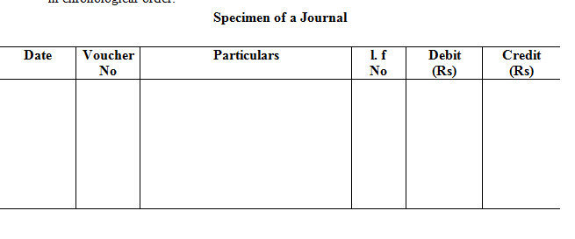
Perform of Journal

Slide 39
Journal
How to Journalize.
Steps used in converting transactions into journal entries.
The following steps should be taken to convert transaction into journal entries.
Record the transaction in the waste book.
Determine the nature of a transaction. Think of the effect of the transaction on the business.
Determine the two aspect of the transaction. ie find out the two account involved
Determine the types of account are affected.
Determine how the accounts are affected. ie giver see who is the receiver or giver or whether these is an expense or loss and income or gain.
Apply the rule of journalizing and decide which account is debited and which account is credited.

Slide 40
Ledger
A ledger is the principle book of account.
A journal is meant for passing the entries of business transaction.
It facilitates posting of transaction to respective ledger account.
All the entries made in the journal must be posted into the ledger.
The ledger is a book containing many ledgers.
The ledger is derived from the Dutch word “legger” which means to lie. Ledger therefore means a book where the various account lies.

Slide 41
Ledger
A ledger helps to achieve the following results.
All personal accounts would show how much money is payable to creditor and receivable from debtors.
The real account would show the value of assets and properties.
The nominal account would show the source of income and the amount spent on various head of expanses.
Features of a ledger.
It is a derived or secondary record.
It is a book of final entry.
It is a king of books of account.

Slide 42
ledger

Slide 43
ledger
Ledger posting and importance.
After the transaction has been analyzed into its debit and credit element in a journal, each such debit and credit element must be transferred to the respective ledger account. The process of transfer of entries from journal to ledger account is called “posting or ledger positing”
Posting is very important as it furnishes the result of all the transactions relating to a particular person or service, after posting one can understand the position of an account at a glance.

Slide 44
Trail Balance
At the end of the financial year or at any other time, the balance of all the ledger account are extracted and are written up in a statement known as trial balance and finally totaled up to see if the total debit balance is equal to the total of the credit balance.
The arrangement of the trial balance reveals that both the aspects of each transaction have been recorded and that the books are arithmetically accurate.

Slide 45
Trail Balance
Features of Trial Balances
The important features of trial balance are as follows:
A trial balance is prepared on a specified date.
It contains a list of all ledger accounts including cash account.
It may be prepared with the balances or totals of Ledger accounts.
Total of the debit and credit amount columns in the trial balance must tally.
If the debit and credit amounts are equal, we assume that ledger accounts are arithmetically accurate.
Difference in the debit and credit columns points out that some mistakes have been committed.
Tallying of trial balance is not a conclusive profit of accuracy of accounts.

Slide 46
Trail Balance
Purposes of a trial balance:
A trial balance is a list of account showing debit balance and cash balance. It serves the following purpose.
To ascertain arithmetical accuracy of the account opened in the ledger.
To known the balance of any ledger account.
To serve as an evidence of the fact that the double entry has been completed in respect of every transaction.
To facilitate preparation of final account promptly.
To help the proprietor to draw conclusions by comparing trial balance of past and present.

Slide 47
Trail Balance
. Limitations of Trial Balances
The important limitations of trial balances are as follows:
The trial balance can be prepared only in those concerns, where double entry system of book-keeping is adopted. This system is too costly.
A trial balance is not a conclusive proof of the arithmetical accuracy of the books of account. It the trial balance agrees, it does not mean that now there are absolutely no errors in books. On the other hand, some errors are not disclosed by the trial balance.
It the trial balance is wrong, the subsequent preparation of Trading, P&L Account and Balance Sheet will not reflect the true picture of the concern.

Slide 48
Trail Balance
Specimen of trial balance:
A trial balance may be prepared in two forms. They are:
Journal form
Ledger form
The trial balance must tally irrespective of the form of a trial balance:

Slide 49
Trail Balance
. Preparation of trial balance:
A trial balance has to be prepared with the help of a ledger and a cash book.
While preparing a trial balance all the personal, real and nominal account have to be considered.
In addition to these, the balance of cash and bank A/c has to be considered.
The ledger account showing the debit balances have to be shown on the debit side of a trial balance and the ledger accounts showing the credit balance have to be shown on the credit side of a trial balance.
If any account does not show any balance. It should be ignored.

Slide 50
Trail Balance
After balance the personal account, a list of account showing debit balance and credit balance should be prepared separately.
A list of account showing debit balance is the list of debtors and a list of accounts showing credit balance is the list of creditors.
After totaling the balance of debtors and creditors. We arrive at sundry debtors and sundry creditors respectively. The balance on those personal accounts of sundry debtors and creditors should not be shown individually.
The sundry debtor should be shown on the debit side of the trial balance and the sundry creditor should be shown on the credit side of trial balance.
Bills receivable accounts had shown a debit balance. This could be shown on the debit side of a trial balance. The bills payable account shows a credit balance which should be shown on the credit side of a trial balance.

Slide 51
Trail Balance
If the bank account shows a debit balance, it indicates a bank balance which should be shown on the debit side of a trial balance. If the bank account has credit balance it indicates a bank overdraft. This should be shown on the credit side of a trial balance. A bank loan account, shows a credit balance which should be taken on the credit side of a trial balance.
A cash account always shows a debit balance or at the most a nil balance. A debit balance on a cash should be shown in the debit column of a trial balance.
The purchase account shows a debit balance which should be shown in the debit column of a trial balance.
.

Slide 52
Trail Balance
The sales account shows a credit balance which should be shown in the credit column of a trial balance.
The return inwards account shows a debit balance and hence should be shown in the debit column.
The return outwards account shows a credit balance and hence should be shown in the credit column.
The opening stock account shown a debit balance which should be shown in the debit column.
.

Slide 53
Trail Balance
. The closing stock will not appear in the trial balance as this account is opened only after the preparation of the trial balance.
Account of assets such as plant and machinery, furniture and fixtures, land and building, motor car, bills receivables, investment, goodwill, trademarks, patent rights, copy rights, etc show a debit balance and as such should be shown in the debit column of a trial balance.
Account of incomes and show credit balance and should be shown on the side on a trial balance.
Account of expenses and losses show debit balance and should be shown on the debit side of the trial balance.

Slide 54
Trail Balance
Methods of Trail Balance
Total method (Gross Trail balance)
Balance Method ( Net Trial Balance)
Combined Method ( Compound Trial Method)
Best Method

Slide 55
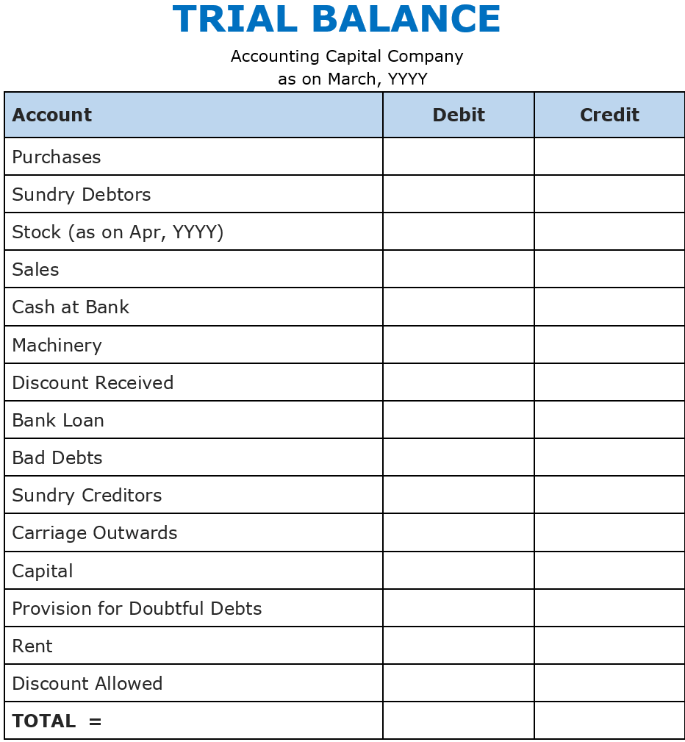
Trail Balance
Performa

Slide 56
Trail Balance
Is Trail Balance Conclusive Proof of Accuracy of Account Books
Errors which cannot be located by trail Balance:
Errors of Omissions:
Errors of Primary records:
Errors in Posting:
Errors of Omissions in Posting.
Compensatory Errors.
Errors in Principles

Slide 57
Trail Balance
Errors which can be located by Trail Balance
Generally the following errors may affect the total of the trail Balance:
Errors made in totaling or carry forwarding the cash forward the
cash book and other subsidiary books.
At the time of posting, errors of not recording an entry in any one
relevant account.
When posting is made in wrong side of the account or wrong
amount in right side.
Mistake made in the total of any A/c or in carry forward of total or
balance to the next page in the ledger.
If entry of an account is not recorded in the trail balance or wrong
amount is recorded or right amount is shown at the wrong side.
Errors made in preparing the list of debtors and creditors.
Errors made in making the total of trail Balance.

Slide 58
Module -II
Cash Book: Single column, double column, three columns, Petty cash book analytical petty cash book, Purchase Book, Purchase Returns Book, Sales Book, Sales Returns, Book, Bills Receivable Book, Bills Payable Books & Journal Proper.
Trial balance: Object, Preparation, Different methods of preparing Trial balance, Closing Entries.
Bills of exchange:- Bills of Exchange and Promissory Note- meaning and Definition, Advantages of Bills of exchange, Parties to a bill Endorsement, Retiring of a bill under rebate, Honour and dis Honour of bills, Bills sent for collection, Discounting of Bills, Accommodation Bills.
Bank Reconciliation Statement: Meaning and Objectives, Causes of differences, Preparation of Bank Reconciliation Statement

Slide 59
Module -II

Slide 60
Cash Book
Cash book is a main subsidiary book as well as well as principle book in subsidiary books of Original entry.
It is a primary book of original entry.
It includes all cash transaction (Payment & receipt of cash) of the business in chronological order.
The cash book represents the true position of flow of cash. Cash book is opened in place of cash book.
Here cash means notes, coins, cheques, banks drafts and postal orders etc.
This is maintained by all organizations, big or small, profit or not for profit.

Slide 61
Cash Book
Features/ Characteristics of Cash Book
Cash book is both a principle book and subsidiary book.
Only cash transactions are recorded in a chronological order.
It performs the functions of both journal and the ledger at the same time.
All the cash receipts are records in the debit side and cash payment are recorded in the credit side.
It records only one aspect of transaction, i.e., Cash
Cash column of the cash book always shows debit balance or equal balance but cannot show credit balance.
In practice, Cash book is substitute of cash book

Slide 62
Cash Book
Difference between Cash Book and Cash Account.
Cash Book | Cash Account
Cash receipts and cash payment are directly recorded into cash book | Cash receipts and cash payments are at first recorded in Journal. After that it is posted to cash account
It is a separate book maintained for recording cash transactions. | It is an account opened in the ledger.
If cash transactions are recorded in cash book then there is no need to open cash account in the ledger. | If cash transactions are recorded in journal, then it is necessary to open cash account in the ledger.

Slide 63
Cash Book
Advantages/ Importance of cash book
Cash book enables a business to know the balance of cash in hand and at bank at any point of time.
It gives information’s relating to daily receipts, payments and closing cash balance at the end of each day.
It transactions of cash are recorded in cash book, there is no need to open a cash account in the ledger.
Cash books checks errors, embezzlement, fraud, cheating and manipulation of cash.
Cash book helps in formulating an effective policy of cash management and future planning of business expansion.

Slide 64
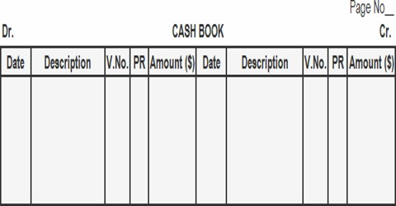
Cash Book
Single Column Cash Book

Slide 65
Cash Book
Two column Cash Book

Slide 66
Cash Book
Three column Cash Book

Slide 67
Petty Cash Book:
A petty cash book is maintained to record small expenses such as postage, stationery, and telegrams. A separate column is used for each type of expenditure.
The difference between the sum of the debit items and the sum of the credit items represents the balance of the petty cash in hand.
A petty cash book also refers to the book in which small payments are recorded, which are not convenient to record in the main cash book.

Slide 68
Petty Cash Book:
Types of Petty Cash Book
There are two main types of petty cash book:
Simple Petty Cash Book
Analytical Petty Cash Book
A simple petty cash book is just like the main cash book.
Cash received by the petty cashier is recorded on the debit side, and all payments for petty expenses are recorded on the credit side in one column.

Slide 69
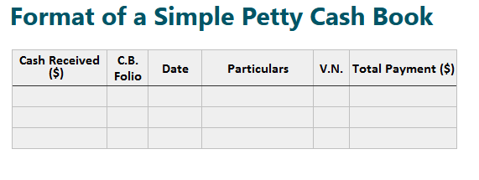
Petty Cash Book:

Slide 70
Petty Cash Book:
Analytical Petty Cash Book
An analytical petty cash book is the most effective way to record petty cash payments.
A separate column is assigned for each petty expense on the credit side.
Whenever a petty expense is recorded in the total payment column.
The same amount is recorded in the relevant petty expense column.

Slide 71
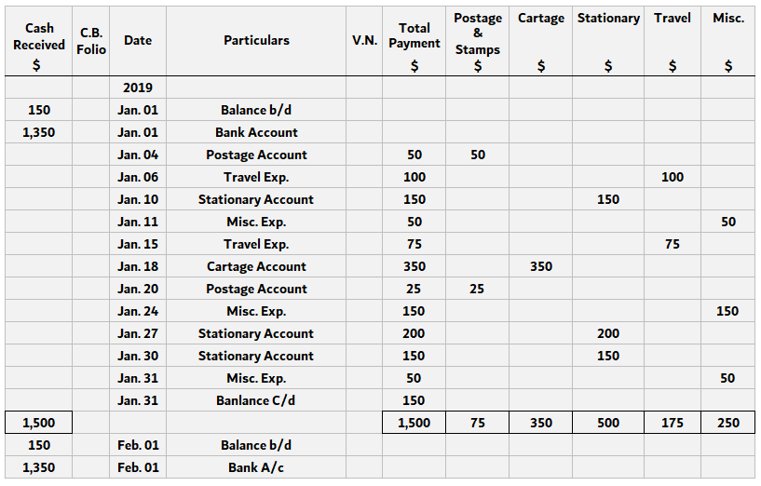
Petty Cash Book:
Analytical Petty Cash Book

Slide 72
Bank Reconciliation Statement
The businessman maintains a cash books with a bank column which shows banking transactions.
Bank column which show banking transactions.
The balance as per this cash book must agree with the balance as per pas book.
However, in practice, it does not match.
In this chapter, we propose to study the causes of disagreement between cash book balance and bass book balance and the process of reconciliation

Slide 73
Bank Reconciliation Statement
Need
It helps to understand the actual bank balance position
It facilitates detection of any mistakes in the cash book and in the pass book
It helps to prevent frauds in recording the banking transactions.
It explains any delay in collection of cheques

Slide 74
Bank Reconciliation Statement
Preparation of bank Reconciliation statement is valued practice of almost all business organizations.
It is an importance technique of internal control of cash inflow and cash outflow.
Both of them must tally as per cash book with the bank statement.
Preparation of Bank reconciliation statement brings into focus the errors and irregularities if any
The employees cannot prepare unauthorized cheques and get them encashed without entering the same in the account.

Slide 75
Bank Reconciliation Statement
Reasons of Disagreement.
The following are the reasons of disagreement between the cash book and bank balance and the pass book bank balance:
Cheques issued but not presented for payment
Cheques deposited in the bank but not collected.
Cheques received and entered in the cash book, but not deposited into bank for collection.
Cheques deposited into bank for collection but not entered in the cash book
Direct payment into the customer’s bank account by other parties but not recorded in the cash book
Interest allowed and credited by the bank
Collection of dividend by the bank
Interested charged or bank charges or commission debited in the bass book

Slide 76
Bank Reconciliation Statement
Procedure of preparation of Bank Reconciliation statement:
Selection of date: select the date on which the bank reconciliation statement is to prepared. Preferably select the last date of the month on which the balance as per Cash Book and Pass Book are known easily.
Comparison of entries: compare the cash book debit column entries with the credit side of the pass book and credit column entries with respective entries in the pass book on debit side. Majority of the items will tally.
Classification of Unticked items: examine the unticked items and list them. Classify them according to their characteristics and headings. The unticked items are the discrepancies.
Selection of the base: Select any balance as a base i.e the starting point. The base may be either cash book balance or pass book balance whichever is given.
Apply the rule of addition and subtraction.
Draw the bank reconciliation statement.

Slide 77
Bank Reconciliation Statement

Slide 78
Module - III

Slide 79
Module - III
Rectification of Errors:
Classification of Errors, Location of errors, Suspense Account, Rectification Entries
Final Accounts: Accounting concept of income, Revenue and Capital, Deferred Revenue Expenditure, Cash Vs. Accrual basis of accounting, Preparation of Trading and P&L A/c., Balance Sheet, Manufacturing Account.

Slide 80
Rectification of Errors.
The fundamental principle of the double-entry system is that every debit has a corresponding credit of equal amount and vice-versa.
Therefore, the total of all debit balances in different accounts must be equal to the total of all credit balances in different accounts.
The tallying of the two totals (debit balances and credit balances) of the trial balance ensures only arithmetic accuracy but not accounting accuracy.

Slide 81
Rectification of Errors.
Objective of Rectification of Errors.
If errors are not rectified. Profit and loss account does not indicate true profit & loss.
If errors are not rectified, Balance sheet does not indicate true financial position.
In addition to above matters, defective accounts create numerous problems at various stages of business. Example: they are not treated as reliable in the court of law.

Slide 82
Rectification of Errors.
Classification of Errors:
Errors of Omission:
Errors in Posting:
Errors in subsidiary books.
Errors of Principles:
Arithmetical errors:
Miscellaneous errors:

Slide 83
Rectification of Errors.
Suspense Accounts: when the Trail Balance does not tally.
Efforts are made to make the trial balance tally, but if this effort fails.
Then temporary the difference of Trail Balance is transferred to an account. This is called Suspense account

Slide 84
Rectification of Errors.
Accounting record in connection with Errors:
First of all it should be seen as to what entry has been made.
Secondly, make the entry which ought to have been made.
Thirdly, after going through the above two entries, pass the rectifying entry.

Slide 85
Rectification of Errors.
Effect on Profit and loss Account.
All such rectifying entries which are related to nominal accounts, affect profit and loss, hence after making rectification, all nominal account which are affected should be taken into consideration and their amounts be considered for assessing the exact amount of loss or profit.
Effect on Balance Sheet.
All such rectifying entries which are related with personal and real accounts effect the balance sheet.
Rectifying entries related with nominal accounts affected profit and loss and this profit or loss is taken to balance sheet. Hence, these entries also affect Balance Sheet.

Slide 86
Rectification of Errors
Stages of Rectification.
First Stage: If the rectification entries are made before preparation of Trail Balance. Then at time of rectification, suspense account will not be made use of.
Second Stage: if rectification entries are made after preparation of Trail Balance and the difference of the trail balance has been transferred to suspense account. Then use of suspense account may be made as per requirement.
Third Stage: If the error is detected after preparation of final account, in this case profit and loss adjustment account is used for rectification as per requirements

Slide 87
Rectification of Errors
Example:01
Payment of rent of office premises Rs. 500 were debited to Landlord Account. In the above case the entry which has been passed is
Landlord A/c Dr. 500
To, Cash A/c 500
However, the entry which should have been passed should be
Rent A/c Dr. 500
To, Cash A/c. 500
Hence, Landlord A/c has been wrongly debited, which should now be credited and rent account earlier omitted from being debited will now be debited. Thus, the rectification entry will be:
Rent A/c Dr. 500
To, Landlord A/c 500

Slide 88
Final Accounts
Manufacturing Accounts
‘Final statements’ generally refer to the two statements prepared by a business concern at the end of every accounting year. They are:
Income statement and
Balance sheet
In case of “Trading Concerns”, these statements are prepared under the headings:
Trading and Profit and Loss account
Balance sheet
In case of “Manufacturing Concerns”, these statements are titled:
Manufacturing, Trading, and Profit and Loss Account
Balance Sheet
In case of “Limited Companies”, they are called:
Profit and Loss Account
Profit and Loss Appropriation Account
Balance Sheet

Slide 89
Manufacturing
Manufacturing concerns which convert raw material into finished product is required to prepare manufacturing account and then prepare trading and profit and loss account. This is necessary because they have to ascertain cost of goods manufactured, gross profit and net profit.
The main purpose of manufacturing account is to show:
Cost of the goods manufactured
Major items of costs such as raw material consumed, productive wages, direct and indirect expenses of production.

Slide 90
Final Account
At the end of the period all the ledger accounts are balanced and then a trial balance is prepared.
Trial balance is used to prepare final account.
Final accounts are prepared to find out the profit and loss and to known the financial position of the business.
These accounts consists of:
Trading account,
The Profit and Loss account,
Balance Sheet.

Slide 91
Final Account
Final account includes trading account, profit and loss account and balance sheet.
Therefore, they are collectively called as final accounts because of the following reasons:
They are prepared at the end of the accounting year.
They are prepared finally, ie: after all books of accounts are closed and trial balance is extracted.
They show the final result of a business.

Slide 92
Final Accounts
The need for preparation of final accounts arises due to the following:
To find out profit/loss on buying and selling of goods.
To ascertain trading efficiency of the organization.
To find out net profit/ net loss after taking into account all the expenses, losses, income and gains.
To ascertain profitability position of an organization.
To ascertain financial position of an organization.
To know about the effectiveness in employment of capital.
To calculate various ratios for the purpose of financial analysis.
To generate valuable information required for decision making in future.

Slide 93
Preparation of Trading Accounts
Trading account and Profit and Loss accounts are summary accounts.
A trading account shows the trading results and trading efficiency.
A trading account is prepared to find out the gross profit or loss in the business done during the year.
The gross profit is the difference between the cost of goods sold and the sales proceeds without any dedication of indirect expenses directly affecting the cost of goods sold.

Slide 94
Trading Account
Thus the cost of goods consists of:
Opening stock of goods + Net purchase – closing stock of such goods + all expenses of bringing the goods in a saleable condition and also to the point of sale. i.e.: all manufacturing expenses
A trading account contains:
Opening Stock + Purchase – closing stock
all manufacturing expenses
All purchasing and

Slide 95
Trading Account
Trading account is required to prepare for the following:
Ascertainment of gross profit or gross loss.
Calculation of cost of goods sold.
Comparison of stock with the previous year’s stock.
Comparison of actual performance with the desired performance.
Comparison of current year’s performance with that of the previous year.

Slide 96
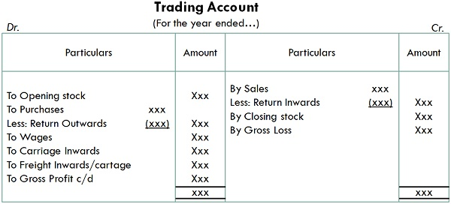
Trading Account

Slide 97
Balancing of trading Account
When trading account is to be closed.
Total both the side of the account.
If debit side is heaver than credit side : it represent a gross loss.
If credit side is heaver the debit side: it represent a gross profit.
Gross profit or gross loss does not represent the true result of the business.
It only shows the trading efficiency.
The balance of trading account is to be transferred to the next account i.e profit and loss account.

Slide 98
Profit & Loss Account
Profit & loss account is another summery account.
Also known as income statement.
Profit & loss account is prepared from trading account.
It shows the Net Profit & Net Loss of the business.
Some expenses of business are not consider while preparing the trading account.
Profit & loss account starts with Gross Profit or Gross Loss.
Gross Profit/ Loss is transferred from the trading account

Slide 99
Profit & Loss Account
Need and Importance.
Profit and loss account is important due to the following.
Knowledge of net profit or net loss.
Ascertainment of ratio of N.P. with sales.
Calculation of expenses ratio to sales.
Comparison of actual performance with the desired performance.
Maintaining provision and reserves.
Determination of future line of action.

Slide 100
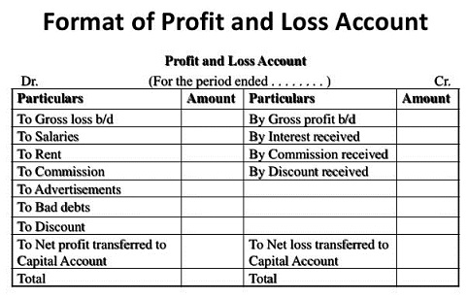
Profit & Loss Account

Slide 101
Balance Sheet
Balance Sheet is a not an account, it is a statement.
A Balance Sheet is a financial statement that summarizes a company's assets, liabilities at a specific point in time.
The balance sheet segments give investors an idea as to what the company owns and owes.
It also inform the amount invested by shareholders.
The balance sheets gets its name from the fact that it as two sides.
Assets on the one side and liabilities plus shareholders on the other side.

Slide 102
Balance Sheet
Liabilities either borrowed money (taking on liabilities) or money collected from investors (issuing shareholders' equity).
A Business has to pay for all the things it owns (assets) through its liabilities.
Liabilities otherwise known as claims,
The balance sheet adheres to the following formula:
Assets = Liabilities + Shareholders' Equity. or
Capital (Equity) = Assets – liabilities

Slide 103
Balance Sheet
Liabilities and Shareholder fund are the sources from which the firm has obtained its funds.
The listing of assets shows the way that the firm's managers have put those funds to work.
The Accounting concept of entity stipulates that the owners of the business are a separate legal entity from the business itself

Slide 104
Balance Sheet
Assets are of two types:
Current Assets: Assets, which are converted into cash in one year or less.
Fixed Assets: Assets which can used (life) more than one year.
Fixed Assets include land, machinery, equipment, buildings and other durable, generally capital-intensive assets.
Assets also includes intangible (non-physical) assets but still valuable, assets such as intellectual property and goodwill

Slide 105
Balance Sheet
Liabilities are the money that a company owes to outside parties
Liabilities are the money that a company owes to outside parties, Like the bills it has to pay to suppliers, The interest on bonds (debt) it has issued to creditors & pay rent, utilities and salaries etc.
Current liabilities are those that are due within one year and are listed in order of their due date.
Long-term liabilities are due at any point after one year.

Slide 106
Balance Sheet
Features:
A balance sheet is a statement and not an account. It has no debit side or credit side.
It is prepared at a particular point of time.
It is a summary of balances of ledger accounts which have not been taken in trading and profit and loss account.
It shows the nature of assets and liabilitie

Slide 107
Balance Sheet
Need and Importance.
Following points explains the need and importance of balance sheets.
Knowledge of financial position.
Ascertainment of current assets and current liabilities.
Ascertainment of proprietor’s equity.
Ascertainment of working capital position.
Comparison of actual position with the desired position.
Comparison of current year’s position with last year’s position.

Slide 108
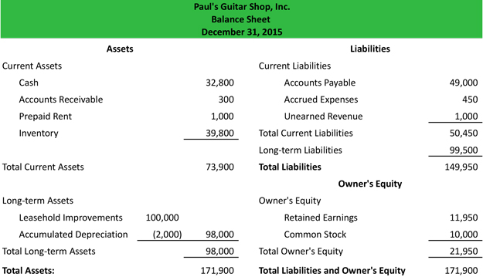
Balance Sheet

Slide 109
Balance Sheet
The entire situation of a business concern can be understood at a glance in a Balance Sheet.
Hence it is rightly said that balance sheet is a mirror of the business wherein the business can see its face.
The two totals of both the sides of the balance sheet must agree with each other.
All the assets and liabilities in balance sheet are carried forward to the next year.

Slide 110
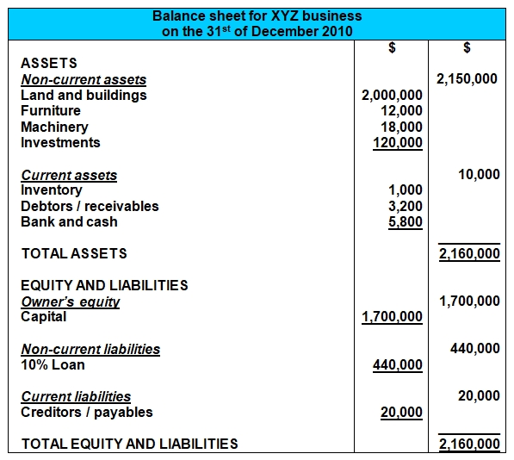
Balance Sheet

Slide 111
Concept of income
Income is defined as the flow of money or goods according to an individual or a group of individuals a firm or the economy over some period.
It generally means a monetary return whether received in cash or kind

Slide 112
concept of Revenue
Revenue, often referred to as sales or the top line, is the money received from normal business operations.
Operating income is revenue (from the sale of goods or services) less operating expenses.
Non-operating income is infrequent or nonrecurring income derived from secondary sources (e.g., lawsuit proceeds).
Non-business entities such as governments, nonprofits, or individuals also report revenue, though calculations and sources for each differ.

Slide 113
concept of Capita
The capital of a business is the money it has available to pay for its day-to-day operations and to fund its future growth.
The four major types of capital include working capital, debt, equity, and trading capital. Trading capital is used by brokerages and other financial institutions.
Any debt capital is offset by a debt liability on the balance sheet.
The capital structure of a company determines what mix of these types of capital it uses to fund its business.
Economists look at the capital of a family, a business, or an entire economy to evaluate how efficiently it is using its resources.

Slide 114
concept of Deferred Revenue Expenditure
Deferred revenue expenditure refers to those expenses which will be incurred in the current accounting period but the benefits of the expenses will be applicable over several accounting periods.
Example: Expenditure on marketing for launching a new product.

Slide 115
Cash Vs. Accrual basis of accounting
Accrual accounting records revenue and expenses when transactions occur but before money is received or dispensed.
Cash basis accounting records revenue and expenses when cash related to those transactions actually is received or dispensed.
Accrual accounting provides a more accurate view of a company's health by including accounts payable and accounts receivable.
The accrual method is the more commonly used method by large companies, especially by publicly-traded companies, as it smooths out earnings over time.
The cash basis method typically is used by sole proprietors and smaller businesses.

Slide 116
Cash Vs. Accrual basis of accounting
Cash basis accounting records revenue and expenses when actual payments are received or disbursed. It doesn't account for either when the transactions that create them occur. On the other hand, accrual accounting records revenue and expenses when those transactions occur and before any money is received or paid out. The

Slide 117
Module - IV

Slide 118
Syllabus
Nature, cause, basic factors of depreciation, Objectives of Providing Depreciation, Methods of depreciation, Fixed instalment Method, DBM, Annuity, Depreciation Fund method, Insurance Policy method, Revaluation method, MHR.

Slide 119
Depreciation
All assets as some value
The value of an asset decreases over time
Decreases due to constant use, wear and tear or obsolescence.
This decrease in the value of an asset is known as depreciation.
The cost of asset is recovered during the life
The cost of the asset recovered should be spread over the life of the asset

Slide 120
Depreciation
Need of Depreciation are:
For determination of net profit or Net loss
For showing assets at fair and true value in the balance sheet.
Provision of funds for the replacement of assets.
Ascertain accurate cost of production.
Distribution of dividend out of profit only

Slide 121
Depreciation
The following factors are to be considered:
The original cost of the asset.
The useful life of the asset.
Estimated scrap or residual value of the asset at the end of its life.
Selecting an appropriate method of depreciation

Slide 122
Depreciation
Depreciation may be defined as the permanent and continuing diminution in the quality or the value of an asset.
= William Pickles
Depreciation is the gradual and permanent decrease in the value of an asset from any cause.
= R.N. Carter.

Slide 123
Methods
The following are the various methods :
Straight Line Method
Written Down Value Method
Annuity Method
Sinking Fund Method
Revaluation or Appraisal Method
Insurance Policy Method
Depletion Method
Sum of the Digits Method
Machine Hour Rate Method

Slide 124
Straight Line Method
The most common method of depreciating assets.
Charges equal amount of depreciation each year over useful life of asset.
Where economic benefits from an asset are expected to be realized evenly over its life.
Formula:
Say: useful life: life expected of assets.

Slide 125
Reducing Balance Method
Also known as Written Down Method (WDM)
This method charges depreciation at a higher rate in the earlier years of an asset.
Some Assets generate more revenue (income) in their early life and less in latter years.
Some assets are used more in their early life.

Slide 126
Sum of the years' digits
This method involves calculating depreciation based on the sum of the number of years in an asset's useful life.
Formula:
Calculate the sum of the years' digits:
If Life expected: 4 years = 4+3+2+1 = 10 years
Calculate the depreciable amount:
= ( Cost - Residual value)

Slide 127
Sinking Fund Method
Sum required to buy (replace) the new asset is available from depreciation or sinking fund.
Annual amount of depreciation is calculated by using an annuity table.
This method is specially applicable to costly machines in large scale industries.

Slide 128
Revaluation Method
In this method the assets are revalued each year.
The method is normally use to charge depreciation on numerous inexpensive fixed assets like small tools, live stock, patents, copy rights and other assets of such nature, which are constantly changing and their period of life is most uncertain
Accordingly periodic inventory is taken of usable items and valued at cost irrespective of ruling prices.

Slide 129
Insurance Policy Method
Insurance policy method is just like sinking fund method of depreciation,
but in this method, the money is used to pay premium for insurance company.
Premium will be charged at the start of the year. Money at the end of maturity can be used to buy a new asset.

Slide 130
Module V
Single Entry System: Advantages and disadvantages of SES, Single Entry vs. Double Entry, Calculation of profits, Statement of affairs method, Conversion method

Slide 131
Module V

Slide 132
Single Entry System
The term 'Single Entry' refers to a method of maintaining the accounts in a manner convenient to a business house.
Does not exactly follow the principles of double entry system.
This system only the minimum accounts.
In other words single entry system is incomplete form of account keeping.

Slide 133
Single Entry System
Incomplete account keeping : This system records double effect of only some transactions. It record only the single aspect of many transactions while it fails to records few other transactions. Hence it is incomplete, defective and crude system.
Variations: The single entry system of accounting varies from business to business. Hence it lacks uniformity.
Flexible : No rigid rules and principles are followed under this system.

Slide 134
Single Entry System
The following are the special features of single entry system :
Unsuitable for big business :This system is suitable only for small business carried on proprietary or partnership basis. Big businesses especially Joint Stock companies cannot afford to maintain accounts as per this system, which is defective and unscientific.
Only personal and cash Accounts : Under this system only the personal accounts of debtors and creditors as well as cash and bank accounts are maintained. The impersonal accounts (i.e. real & nominal accounts) are not maintained.

Slide 135
Single Entry System
Advantages of Single Entry System
Easy to understand: A single entry system is very easy to understand even a layman can understand. so, prepare the accounts is very easy.
Cost-effective: In single entry system we not require any accountant and chartered accountant for audit the account so the cost is very less cooperative to double-entry book-keeping system
Time-Saving: Under single entry system, we record only one entry for every transaction thus, this lead to time-saving for the business
Good For Small Business: Small business can implement the single entry system as it is cost-effective and easy to understand
Helps in Decisions Making: It provides the basic information to the manager about the sales and profit so they can make decisions accordingly

Slide 136
Single Entry System
Disadvantages of Single Entry System
low accuracy: In this system, the accuracy of the account is low as we record only one aspect of the transactions.
Calculation Error: If there is any calculation error so we not have cross-checking option as we have in the double-entry system.
Not Able to Prepare Financial statement: In Single system, we can not prepare the financial statements Profit & Loss Account and Balance Sheet.
Manipulation of Account: under this system manipulation of the account is very easy there is no cross-check option.
Personal Biasedness: Account can be biased but it depends upon who prepares the accounts.

Slide 137
Single Entry System
Difference between Single Entry System & Double Entry System.
Single entry is an in-complete system of accounting, whereas double entry system is a complete system of accounting transactions.
There is no reliability on books in a single entry system, whereas double entry system is a reliable accounting system.
Checking of the arithmetical accuracy is possible in a double entry system through preparation of trial balance, whereas it is not possible under a single entry system.
Since, single entry system does not maintain Trading, and Profit & Loss Account, and Balance Sheet; hence, ascertainment of the actual profit and exact financial position of the firms is not possible, on the other hand, all above is quite possible under the double entry system of accounting

Slide 138
Single Entry System
Limitations of Single Entry System
Preparation of Statement of Affairs
To know the financial position of a business, the list of assets & liabilities and statement of affairs are prepared on the last date of accounting period. As stated earlier, in the absence of real accounts, it is not possible to prepare a Balance sheet.
Following points are required to prepare the statement of affairs −
With the help of personal accounts, a list of debtors and creditors should be prepared.
Stock valuation method will be either on cost or market price, whichever is lower.
Cash book balance should be physically verified with the cash book.
Bank balance should also be reconciled with the Bank statements.

Slide 139
Single Entry System
Preparation of Statement of Affairs
Following points are required to prepare the statement of affairs −
With the help of personal accounts, a list of debtors and creditors should be prepared.
Stock valuation method will be either on cost or market price, whichever is lower.
Cash book balance should be physically verified with the cash book.
Bank balance should also be reconciled with the Bank statements.
Statement of affairs should contain the income received in advance and the expenses paid in advance.

