Slide 1
Price & Output Determination Under Different Markets Structures
Duna Jogeswar Rao

Slide 2
Price & Output Determination under perfect Competition
Under perfect competition, the buyers and sellers cannot influence the market price by increasing or decreasing their purchases or output, respectively. The market price of products in perfect competition is determined by the industry. This implies that in perfect competition, the market price of products is determined by taking into account two market forces, namely market demand and market supply.
In the words of Marshall, "Both the elements of demand and supply are required for the determination of price of a commodity in the same manner as both the blades of scissors are required to cut a cloth.” As discussed in the previous chapters, market demand is defined as a sum of the quantity demanded by each individual organizations in the industry. In perfect competition, the price of a product is determined at a point at which the demand and supply curve intersect each other. This point is known as equilibrium point as well as the price known as equilibrium price.

Slide 3
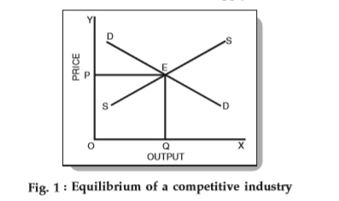
Price Determination by Equilibrium Between & Supply:
In economic terms, an industry consists of many independent firms. Each firm has a number of factories, farms or mines, as required. Each such firm in industry produces a homogeneous product. Equilibrium of the industry happens when the total output of the industry is equal to the total demand. In such a scenario, the prevailing price of a commodity is its equilibrium price.
OP is the equilibrium price. Further, OQ is the equilibrium quantity sold at that price. Now, the equilibrium price is the price at which both the demand and supply are equal. In other words, no buyer, who wanted to buy at that price, goes dissatisfied and no seller, who wanted to sell his goods at that price, goes dissatisfied either.
Note that with the demand remaining the same, if the price is higher or lower than OP, then the market is not in equilibrium. Also, if goods are lesser or higher than the demand, the equilibrium is not attained.

Slide 4
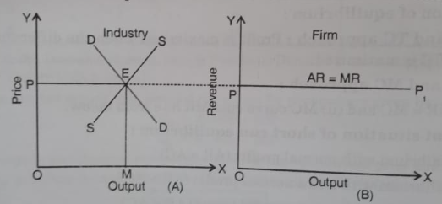
Price of the Product
The firm is price taker: While discussing the characteristics of perfect competition we have stated that in this market form the number of buyers and sellers is so large that no one is able to influence the market price. In other words, every firm has to accept the price determined by the joint actions of all buyers and sellers. Accordingly each individual firm under perfect competition is not a ' Price maker ' but is only a ' Price taker '. But what price does it take ? It is demonstrated with the help this figure.

Slide 5
Continue…
In this Figure (A) total demand curve DD intersects industry's supply curve SS at point E. Thus point E is the equilibrium point and OP is the equilibrium price. The individual firms must take this price as given. Fig. 1 (B) refers to firms demand curve. The firm will have to sell all its output at the prevailing price OP. It may sell more units or less units, but it will charge OP price only. As such, firm's demand curve (PP₁) will be parallel to OX - axis, or perfectly elastic signifying that the firm can sell any number of units at OP price.
A competitive firm can sell one more unit of output without reducing the price it receives for its previous units, so total revenue will rise by an amount equal to the price. We know that rise in total revenue by selling, one more units is marginal revenue (MR). Thus average revenue or price is equal to marginal revenue for the competitive firm (P = AR = MR).

Slide 6
The Quantity to be Produced
How Much to be Produce
If the firm decides to produce another related decision it has to take is the quantity. A firm, in all circumstances, would like to produce that quantity of output at which its profits are maximum (or if the firm is undergoing losses we will say that output at which its losses are minimum). There are two complementary approaches to determining the level of output at which a competitive firm will realize maximum profits or minimum losses or will be in equilibrium.
Total Revenue and Total Cost Approach.
Marginal Revenue and Marginal Cost Approach.

Slide 7
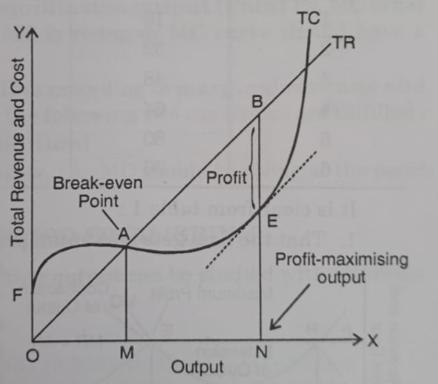
Total Revenue and Total Cost Approach
A firm is in equilibrium when it produces that amount of output at which the difference between total revenue (TR) and total cost (TC), i.e., total profit, is maximum. This situation is shown in this Figure. In this figure:
(A) Break - even - point: In this Figure OM is the break - even - level of output because corresponding this at point A total revenue curve (TR) cuts the total cost curve (TC) showing that the two are equal.
(B) Equilibrium output: In this Figure the profits are maximum at ON level of output where the profits that is, difference between TR and TC is equal to BE. BE is the largest. Thus, the firm will be in equilibrium when it produces profit maximizing level of output ON.

Slide 8
Marginal Revenue and Marginal Cost Approach
Another method to find out the profit maximizing output and price for a firm under Perfect Competition is to calculate its marginal cost (MC) and marginal revenue (MR) at different levels of output Profit will be highest at that level of output where marginal cost coincides with the marginal revenue, i.e., MC = MR
Marginal revenue (MR) means the addition made to the total revenue by producing and - selling an additional unit of output and
Marginal cost (MC) means the additional made to the total cost by producing an additional unit of output.
Now, a firm will go on expanding output as long as marginal revenue (MR) exceeds marginal cost (MC) of production. If at any output marginal revenue falls, short of marginal cost, i.e., if an additional unit of output adds less to revenue than to cost. The firm will contract output to avoid losses and thus increase its profits. The level of output where marginal revenue (MR) and marginal cost (MC) equal is the point of maximum profit. This could be explained with the help of a table given next slide:

Slide 9
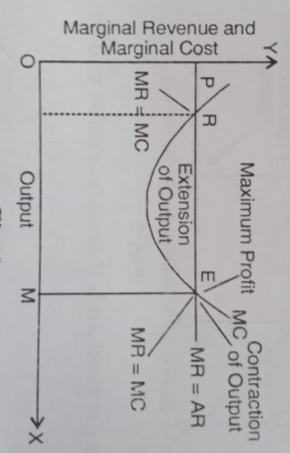
Continue…
Cost and Revenue Schedule of a Firm (In ₹)
Unit of Commodity | TR | AR/MR Price | TC | MC | Total Profit
0 | 0 | 0 | 0 | 0 | 0
1 | 16 | 16 | 20 | 20 | 4
2 | 32 | 16 | 36 | 16 | -4
3 | 48 | 16 | 44 | 8 | +4
4 | 64 | 16 | 54 | 10 | +10
5 | 80 | 16 | 70 | 16 | +10
6 | 96 | 16 | 90 | 20 | +6

Slide 10
Continue…
It is obvious from the previous slide Figure, that at the level of equilibrium output (Point E), MC is not only equal to MR but it cuts MR from below, i.e., MC is rising or MC curve should have a positive slope.
On the basis of above analysis, we can conclude that according to marginal revenue and cost approach, firm would be in equilibrium when the following two conditions are fulfilled :
MC = MR (Necessary or First Order Condition)
MC Curve intersects MR Curve from below, i.e., MC should be rising at the point of equilibrium (Sufficient or Second Condition).

Slide 11
Equilibrium of a Firm in the Short Run
In the short run, the firm's equilibrium would be established at the level of output where
(i) MC = MR and
(ii) at the equilibrium point MC must be increasing.
But it must be remembered that the equilibrium output does not guarantee profits to all the firms. The equilibrium output is the best determined output for a firm under the given circumstances. Thus, we can define a firm's equilibrium more precisely as follows :
A firm's equilibrium is a level of output at which a firm either maximizes its profits or minimizes its losses.
Some firm may earn super normal profit in the short period in equilibrium condition, some may suffer losses and some may earn normal profit only.

Slide 12
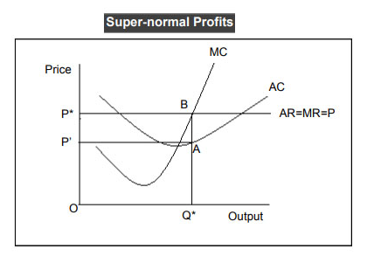
Equilibrium at Super Normal Profit
In this figure, the per unit revenue or average revenue is OP* while the per unit cost or average cost is OP’. Therefore, the per unit receipts are high in comparison with the per unit cost.
That’s why the average revenue curve lies above the average cost curve corresponding to Q*. The firm is earning super-normal profits. The per unit profit is P’P* and the total profit is for quantity OQ* is P’P*BA.

Slide 13
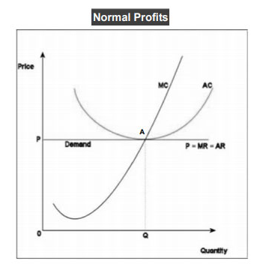
Equilibrium at Normal Profit
In this figure, you can see that the costs and revenue are on the Y-axis and the Quantity is on the X-axis. Further, marginal costs cut the marginal revenue curve from below at point A. At point ‘A’, P is the equilibrium price and ‘Q’ is the equilibrium quantity.
Note that corresponding to the equilibrium quantity, the average cost is equal to the average revenue. It also means that the firm is earning a normal profit.

Slide 14
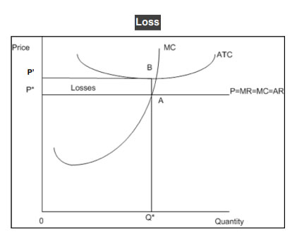
Equilibrium at Losses
In the figure above, the cost and revenue curves are on the Y-axis and the quantity demanded is on the X-axis. Further, the marginal cost curve cuts the marginal revenue curve from below at point ‘A’, the equilibrium point.
Corresponding to point ‘A’, P* and Q* are the equilibrium price and quantity respectively. Also, corresponding to Q*, the average cost is more than the average revenue.
In this case, the per unit cost of OQ* (average cost) is more than the per unit revenue of OQ* (average revenue). As per the figure, the per unit revenue is OP and the per unit cost is OP’. this means that the per unit loss is PP’. Also, the total loss on quantity OQ* is P*P’BA.

Slide 15
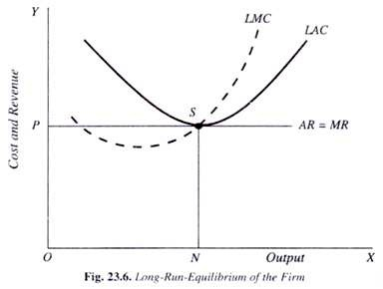
Equilibrium of a Firm in the Long Run
The long run is a period of time which is sufficiently long to allow the firm to make changes in all factors of production. In the long run, all factors are variable. In economics long run is that time period in which there is no fixed factor. Every factor can be changed. Firm can alter its size of the plant. New firm can enter the industry or old firms can leave it. In this way, in the long - period supply can be fully adjusted with the demand. So equilibrium firm gets inly normal profit, lesser profit in long period.

Slide 16
Determination of Price and Output under Monopolistic Competition
In the situation of monopolistic competition, each competitive firm has partial control over the price of its product, as indicated by the negative slope of its demand curve (AR curve). Each monopolistically firm of a differentiated product behaves so as to get maximum profit.
Determination of equilibrium of a monopolistic competitive firm follows the same general rule of profit maximization that we have illustrated in the context of a perfectly competitive firm and monopoly firm. To repeat the equilibrium condition, it is determined at the level of output where a firm's
(i) MR = MC and
(ii) MC curve cuts MR curve from below
It may be stated that Chamberlin did not use MC and MR curves, but they are implicit in his analysis.
Study of firm's equilibrium under monopolistic competition is attempted with reference to two different time periods : (i) Short period and (ii) Long period.

Slide 17
Short Period Equilibrium in Monopolistic Competition
In the short - run, a monopolistic competitive firm's equilibrium is established at the level of output where its MC = MC, and MC is rising, at this level of output.
Short period equilibrium does not mean the same price for all firms. Uniformity in prices cannot be expected because the products of various firms are not identical. Cost of production of firms also various. Normally average cost (AC) of large firms is less whereas it is high for small sized firms. Therefore, it is likely that supernormal profits for some firms, normal profits for some others and loss to remaining firms would accrue. Thus, a monopolistic competitive firm, in the short - run, may
(i) Earn super normal profits, i.e., AR > AC
(ii) Earn normal profits, i.e., AR = AC
(iii) Incur losses, i.e., AR < AC

Slide 18
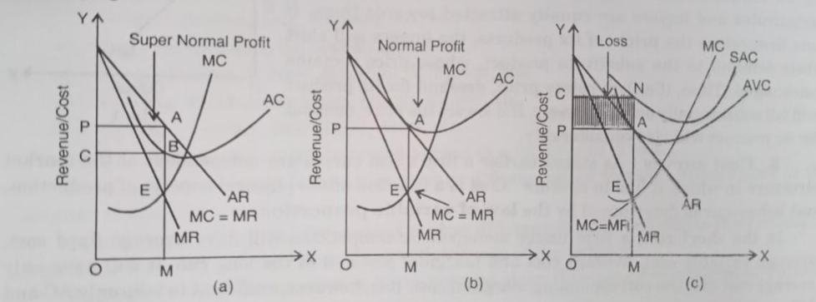
Three Situations for monopolistic competitive firm

Slide 19
Conclusion
If marginal revenue (MR) is equal to marginal cost (MC), the firm is in equilibrium. The firm raises its production to OM level.
If the average revenue (AR) is more than average cost (AC), the firm enjoys super normal profits.
If the average revenue (AR) coincides with average cost (AC), the firm earns only normal profits.
If the average revenue (AR) is less than the average cost (AC), the firm suffers loss. However, if the firm is able to fetch a price which covers at least the average variable cost, it will continue to stay in production.
If the average revenue (AR) slumps below the average variable cost (AVC), the firm will shut down production.

Slide 20
Price and Output Determination in the Long Period
A monopolistically competitive firm will be in long run equilibrium at the output level where marginal cost ( MC ) equals marginal revenue ( MR ) . In the long run , the firm under monopolistic competition will Earn only normal profits .
( i ) Firms will not earn super normal profits : There is no restriction in monopolistic competition as to the entry or exit of new firms . If the existing firms make super normal profit , new firms will enter the industry . When more and more new firms enter the industry the price will fall and it will near the average cost . The entry of new firms will increase production . But the increase in production does not increase sales . The new firms as well as existing firms are to compete with the existing reputed firms . To compete with the existing reputed firms the new firms introduce their product at a lower price . Thus , the existing firms are also compelled to reduce the price of their product . Now the price tends to equal the average cost . The individual firm will earn only normal profit . Profits are only normal when average revenue equals average cost . So the monopolistically competitive firm will be in long - run equilibrium when firms earn only normal profit which forms part of the cost of production .

Slide 21
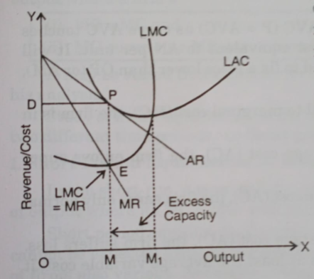
Continue…
( ii ) Firms will not incur losses : A monopolistically competitive firm in the long - run will not incur loss . If the firms incur loss , some firms will leave the industry thus reducing the total production. Now the price will again rise sufficiently to cover the average cost of production.
The forgoing analysis makes again it clear that in the long-run only normal profit are available to the firm.

Slide 22
Determination of Price, Output and Firm Equilibrium under Monopoly Competition
Equilibrium under Monopoly Competition: Like the firms working under perfect competition , the goal of the monopolist is also to maximize profits . The monopolist gets maximum profit when he is producing equilibrium output . Under monopoly equilibrium output and price are determined by two different approach.
Total Revenue ( TR ) and Total Cost ( TC ) Analysis ;
Marginal Revenue and Marginal Cost Analysis .
Total Revenue and Total Cost Analysis: The TR and TC curves method applies to a monopoly firm as well as firms in other kinds of market structure . According to this approach a firm is in equilibrium when it produces that amount of output at which the difference between total revenue ( TR ) and total cost ( TC ) , i.e .; total profit , is maximum .

Slide 23
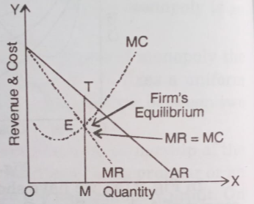
Equilibrium under Monopoly Competition
Marginal Revenue and Marginal Cost Analysis: Another method to find out the profit maximizing output and price for a firm under monopoly is to calculate its marginal cost ( MC ) and marginal revenue ( MR ) at different level output . According to this approach , a monopolist will be in equilibrium when two conditions fulfilled , i.e. , ( i ) MC = MR and ( ii ) MC must cut MR from below , i.e. , slope of MC > slope of MR Once the profit maximizing output level is determined , the monopolist finds out the price which this quantity can be sold . Accordingly the price is determined .

Slide 24
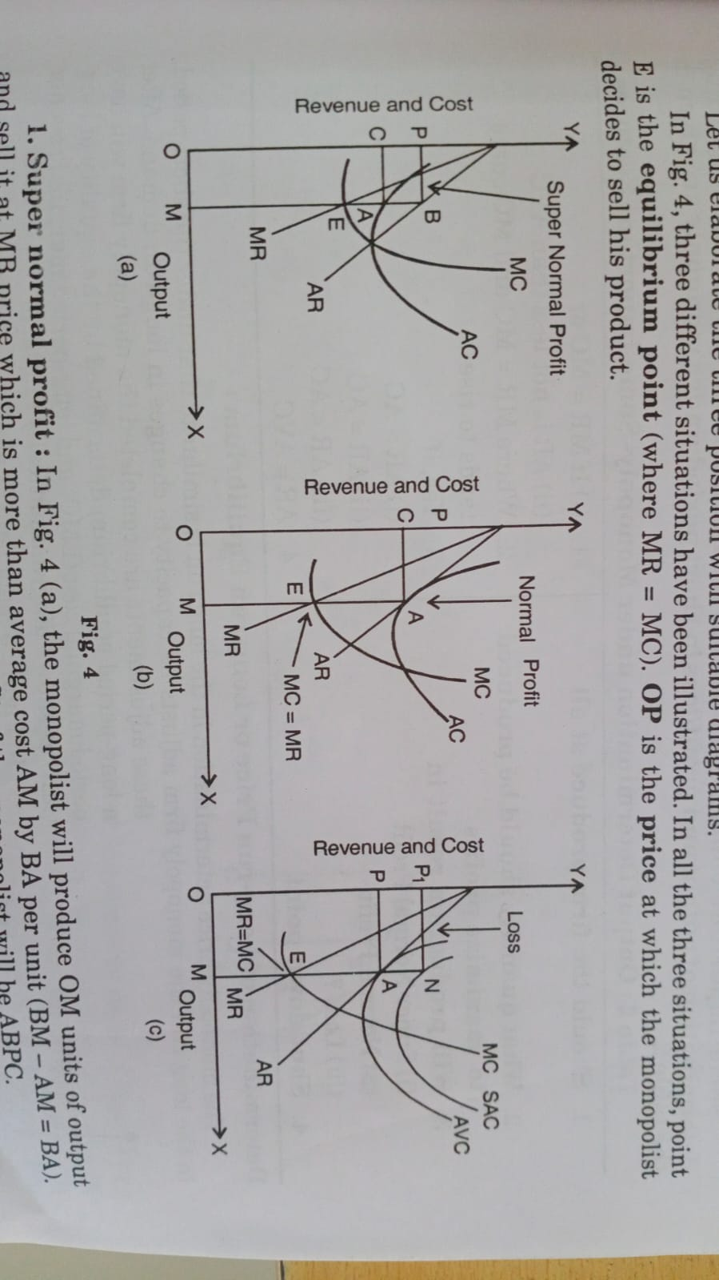
PRICE AND OUTPUT DETERMINATION UNDER SHORT PERIOD OR SHORT - RUN EQUILIBRIUM
In the short period , the time available is not sufficient to alter production , to adjust with the demand . So in the short - run a firm can be in equilibrium in the following three positions with respect to profits .

Slide 25
PRICE AND OUTPUT DETERMINATION UNDER SHORT PERIOD OR SHORT - RUN EQUILIBRIUM
Super normal profit : In Fig, the monopolist will produce OM units of output and sell it at MB price which is more than average cost AM by BA per unit ( BM - AM = BA Thus , in this situation the total super normal profit of the monopolist will be ABPC .
Normal profit : In Fig ., OM is equilibrium output . At this output , average cost ( AC ) curve touches average revenue ( AR ) curve at point A. Thus , at point ' A ' price OP ( AR ) is equal to the average cost ( AM ) of the product . Monopoly firm , therefore , earns only normal profit in equilibrium situation , as at equilibrium output is AC = AR .
Incurring loss : In Fig ., OM output is being produced at MN cost per unit , but this is being sold at AM price per unit . Monopolist incurs a loss of AN per unit . His total loss is being represented by the shaded area ANP₂P .

