Slide 1
PERFORMANCE APPRAISAL

Slide 2
Course Profile
Course Title | Performance Appraisal & Management
Code | MSMSR/MBA 306(H)
Program | MBA
Total Credits
Total Number of Sessions | 50
Session Duration | 45 minutes
Faculty/course facilitator | Dr. Bharati Pujari

Slide 3
Course Objectives
The objective of this course is to equip students with comprehensive knowledge and practical skills to improve their ability for performance appraisal in their organisations.
It is particularly intended for future managers and supervisors who will conduct the performance appraisal of their subordinates

Slide 4
Syllabus
Module 1:-Concept, Characteristic, Role, Objectives and Significance of Performance Appraisal; Performance Appraisal vis-a-vis Performance Management, Process of Performance Management; Performance Management and Strategic Planning Linkages.
Module 2:-Historical Review of Performance Appraisal, Job Description and Performance Appraisal, Job Analysis in Performance Appraisal Systems, Performance Planning and goal setting, Process and Documentation of Performance Appraisal; Appraisal Communication ; Appraisal Interview; Performance Appraisal and its Organisational Implications

Slide 5
Syllabus
Module 3:-Establishing and operationalising performance management system; measuring performance-results and behaviour; conducting performance review; Methods of Performance Appraisal; Appraisal Forms and Formats; performance and training, performance feedback coaching and counseling; harnessing performance management system for performance improvement.
Module 4:-Performance management strategic and interventions; reward based performance management; career based performance management, term based performance management.
Module 5:-Issues and Problems in Performance Appraisal, Culture based performance management; measurement based performance management; competency based performance management; leadership based performance management; Legal and Ethical Perspectives in Performance Appraisal.

Slide 6
Module-1
Definition- Performance appraisal is an objective assessment of an individual performance against well defined benchmarks.

Slide 7
Characteristics
Fair & Accurate
The system must be efficient
Continuous, Flexible & Intuitive
The system must focus on Employee Development
Aligned towards org. goals
Aligned towards org. culture & values
The system must help with goal setting & tracking
Integrates all aspects of employee development
Customization, security & Integration

Slide 8
Objectives Of Performance Appraisal.
Developmental Uses.
Administrative Uses.
Organisational/ Maintainence Uses.
Documentation Purposes.

Slide 9
Significance
It Provides a Look into the Future
Helps Create Development and Training Strategies
Provides Clarity in the Organization
Provides the Opportunity for Exchanging Feedback
Increases Employee Retention
It encourages employee recognition and reward
Boosts Employee Engagement
It helps in boosting employee productivity and engagement
Helps to enforce goal setting and achievement
It offers mentoring for increasing performance

Slide 10
Comparison
Performance appraisal evaluates previous performances and effectively communicates how an employee has worked in a current task. It does not provide a strategy for future growth.
Performance appraisal only evaluated employee’s performance objectively for the year and gave final feedback
Performance appraisal evaluates an employee's mistakes and communicates how an employee could have given better efforts.
Performance appraisal takes place not more than twice a year.
Performance appraisal typically uses a quantitative approach.
Performance management is flexible.
Performance management, on the other hand, focuses on expending time and resources on employees for the growth of the company.
Performance management ensures that the employee has accomplished the set goals or not. It also guides them with blockers on the way.
Performance management, on the contrary, guides employees so that they can perform better in the future.
Performance management contrastingly is a continuous process
Performance management, however, uses a mix of both qualitative and quantitative approaches
Performance appraisal is inflexible.

Slide 11
Example of Performance Appraisal
BC company has done significantly well in the last few months. There has been a considerable reduction in overhead costs and the production has improved by 39%. Undoubtedly, it is because of the employees who managed to achieve their goals. Based on the feedback we have received so far, it is evident that our employee Samaira Chaudhuri has made notable contributions to this project.
Employee name - Samaira Chaudhuri
Position - Marketing Manager
Employer name - Nishant Ray
Department - Marketing
Review period - January 8, 2021 - April 7, 2021
Samaira has shown clear communication in expressing her expectations and ideas. She efficiently organizes meetings and seminars, and effectively conveys her messages to the clients.
Samaira has shown commendable levels of dedication and perseverance in achieving company goals. She has improved her productivity by 79%

Slide 12
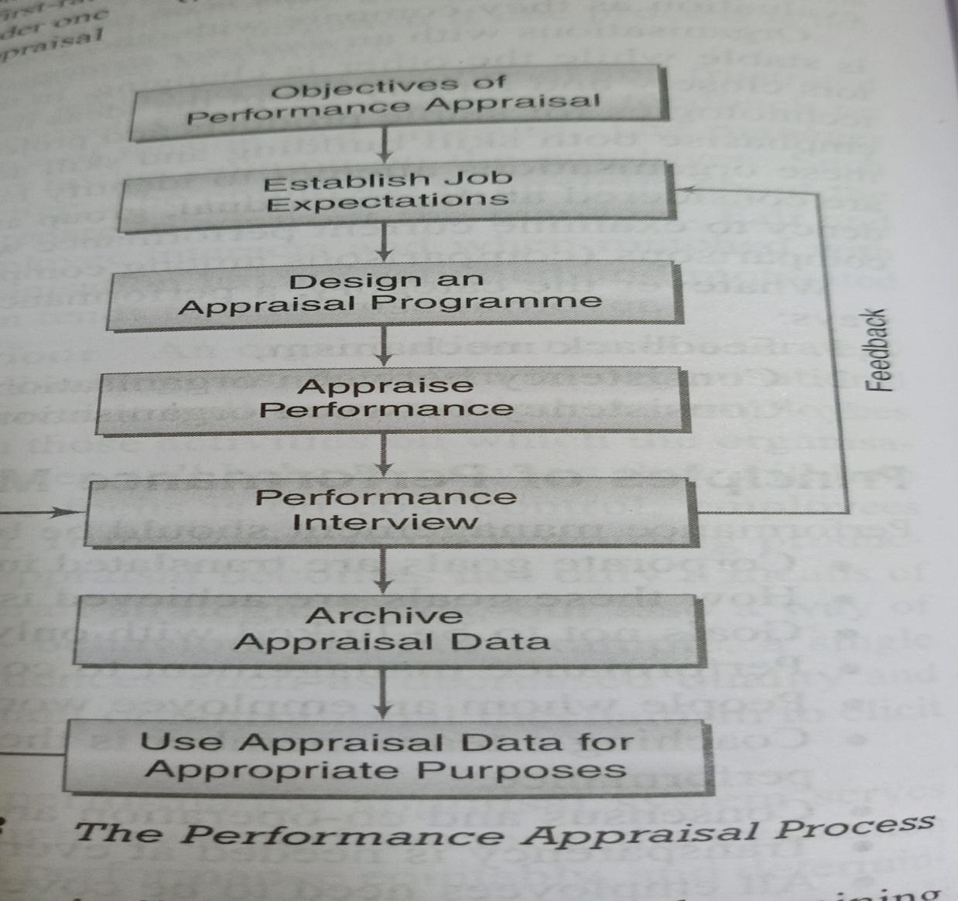
Performance Appraisal Process

Slide 13
Design Appraisal Programme
Formal vs. Informal
The first step in designing the appraisal programme is to decide the appraisal should be formal or informal. Formal Appraisals usually occur at specified time periods-once or twice the year.
Informal appraisals can take place whenever supervisor feels the need for communication.

Slide 14
Designing an appraisal program poses several questions, which need answers. They are:
1. Whose performance is to be assessed????
2. Who are the appraisers????
3. What should be evaluated????
4. When to appraise????
5. What problems are encountered????
6. How to solve the problems????
7. What methods of appraisal are to be used????

Slide 15
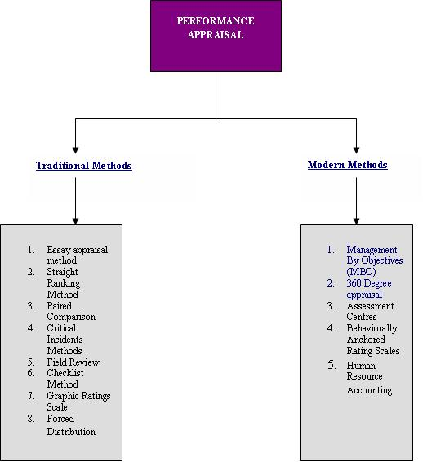
Performance Appraisal Methods

Slide 16
Use of Appraisal Data
Remuneration administration.
Validation of selection programmes.
Employee training and development Programmes.
Promotion, transfer and lay off decision.
Grievance and Discipline Programmes.
HR planning.

Slide 17
PERFORMANCE APPRAISAL USED BY NOKIA
Nokia holds a strategy review process every six months - a year being too long in the mobile phone business. The review is followed by a discussion with individuals about what they need to be doing and the support they need to do it. According ot them, "If a person is clear on what to do, you don't need to tell them. They're naturally empowered. What's important is the quality of the discussion.

Slide 18
WHY DID IT BEGAN
HCL realized that in service industry the value gets created not in the back office but in face to face interaction between the customer and employees.
Hence it is important to empower employees so that they deliver more value to the customers. When an employee is delighted, he will delight the customer.
This gave birth to a path breaking philosophy called :
'Employee First, Customer Second‘, termed by Fortune
as "The most modern management idea

Slide 19
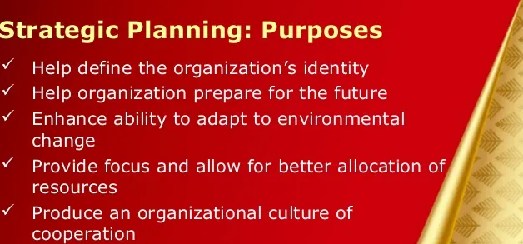

Slide 20
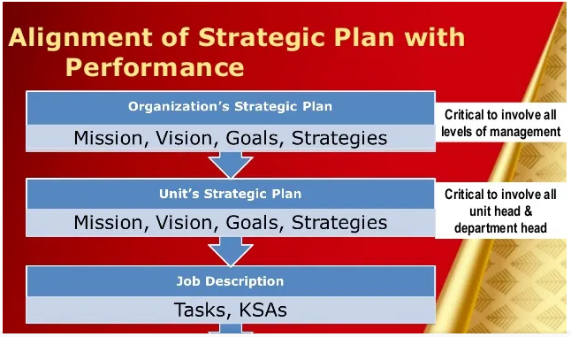
Performance management & Strategic Planning

Slide 21
