Slide 1
MODULE-3

Slide 2
LEADERSHIP
Leadership is the ability to influence a group toward the achievement of goals.
Leadership is a function of knowing ones self, having a vision that is well communicated, building trust among colleagues, and taking effective action to realize ones own leadership potential.

Slide 3
TYPES OF LEADERSHIP STYLES
LEADERSHIP STYLES | DECISIONS MAKING STYLE | MEMBERS’ DEPENDENCY LEVEL | RESULTS | APPLICATION
AUTOCRATIC | No chance for suggestions / opinions from others | High | High Alienation & Demotivation | Quicker Members are not experts High level of control
DEMOCRATIC | Consultative & Persuasive | Moderate | High Team Effectiveness & Motivation for new ideas | Slower, Members are equally efficient High involvement
FREE-REIGN | Shared Responsibility | Independence | High motivation, Self-monitoring, Good Team & Interpersonal relations | Creative ideas are the core business No need for close monitoring
PATERNALISTIC | Makes Self-decisions & Rarely Consults | Moderate | Welfare & Supportive Work Environment | Policy Formulations Members unaware of own strengths

Slide 4
THEORIES OF LEADERSHIP
Traits Theories
Behavioral Theories
Contingency / Situational Theories
Transactional Theories
Transformational Theories and
Charismatic Theories of Leadership

Slide 5
THEORIES OF LEADERSHIP (Contd.)
Factors determining leadership strategies of Traits based Leaders
Extraversion
Conscientiousness
Openness
Emotional Intelligence
Trait Theories of Leadership
Considers personality, social, physical, or intellectual traits to differentiate

Slide 6
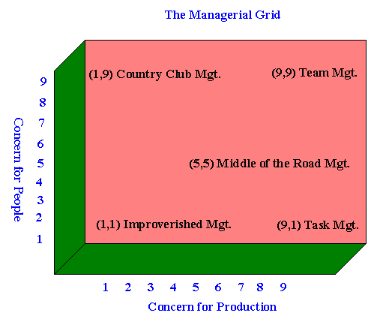
THEORIES OF LEADERSHIP (Contd.)
Behavioral Theories of Leadership
Specific behaviors differentiate leaders from non-leaders.
Factors determining leadership strategies of Behaviour based Leaders
Initiative
Consideration
Employee orientation
Production orientation
Development orientation

Slide 7
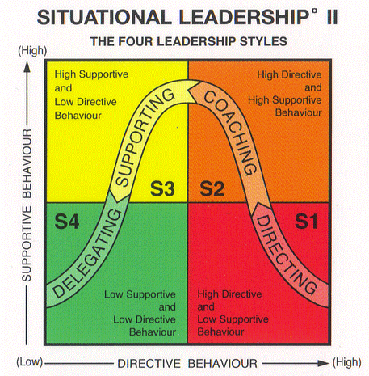
THEORIES OF LEADERSHIP (Contd.)
Factors determining leadership strategies of Contingency based Leaders
Leader-Member relations
Leader readiness to delegate
Follower readiness to accept responsibilities
Task structure
Positional power
Contingency / Situational Theories of Leadership
Blend of a leader’s style and the degree to which the situation gives control and influence to the leader.

Slide 8
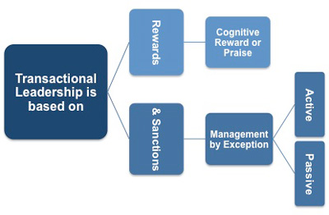
THEORIES OF LEADERSHIP (Contd.)
Transactional Theories of Leadership
Guides or motivates the followers in the direction of established goals by clarifying role and task requirements.
Factors determining leadership strategies of Transaction based Leadership:
Management by reward
Management by Exception
Laissez-Faire

Slide 9
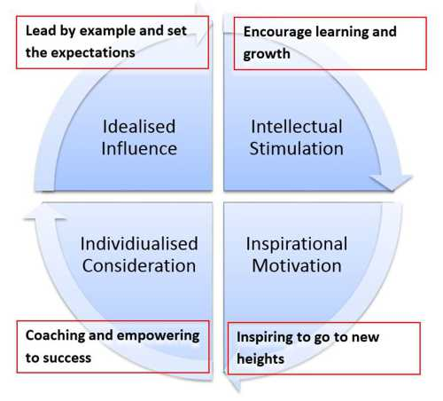
THEORIES OF LEADERSHIP (Contd.)
Factors determining leadership strategies of Transformation based Leaders (4 ‘I’s):
Idealized Influence
Inspirational Motivation
Intellectual Stimulation
Individual Consideration
Transformational Theories of Leadership
Adopts transformational approaches using the 4 ‘I’s rather than a conventional or transactional approaches

Slide 10
THEORIES OF LEADERSHIP (Contd.)
Theories of Charismatic Leadership
Followers attributions of heroic or extraordinary leadership abilities when they observe certain behaviors.
Factors determining leadership strategies of Charismatic Leaders
Self Confidence
Visionary
Being a change agent
Environmental sensitivity & needs of the followers
Willingness to take personal risks to achieve the vision.

Slide 11
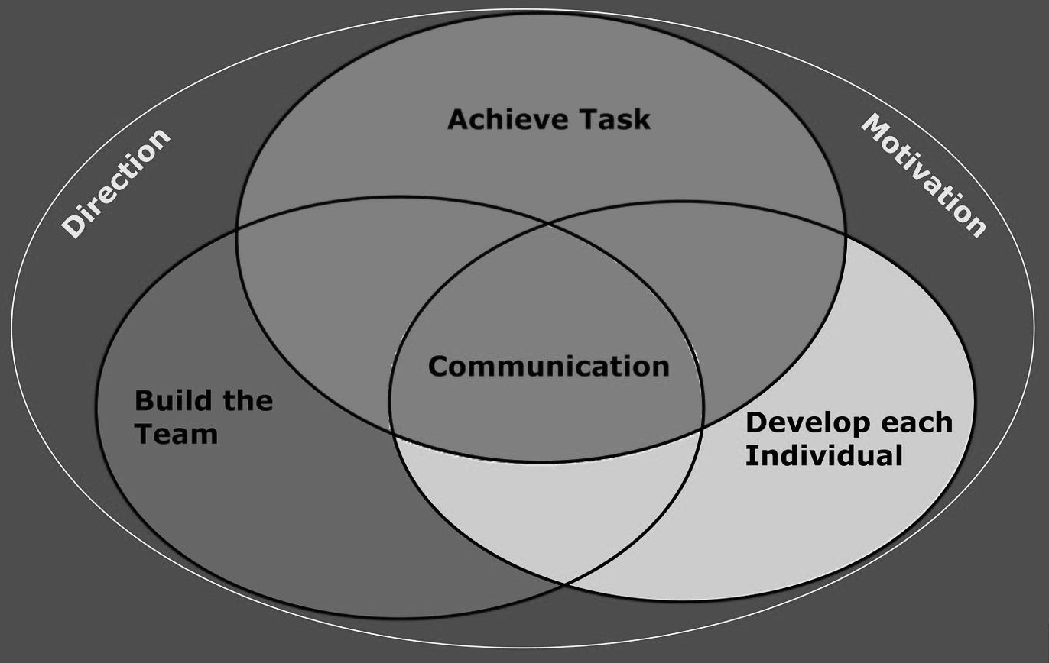
TEAM, LEADERSHIP & MOTIVATION LINKAGE MODEL

Slide 12
MOTIVATION

Slide 13
Definition of Motivation
Motivation - the process of arousing and sustaining goal-directed behavior.
Notes:
2
2
6
6
6
6

Slide 14
Nature
Motivation is internal to man.
A single motive can cause different Behaviour
Different motives may result in single behaviour
Motives come and go
Ongoing process
Complicated process

Slide 15
Importance
To keep employees happy
To instill human treatment
To increase work efficiency
To improve communication
To combine ability with willingness
To reduce the rate of labour turnover
To develop the leadership quality

Slide 16
Maslow’s Hierarchy of Needs
SA
Esteem
Lowest to highest order
Love (Social)
Safety & Security
Physiological
Notes:
6
4
2
2
2
5

Slide 17
Alderfer’s ERG Theory
SA
Growth
Esteem
Relatedness
Love (Social)
Safety & Security
Existence
Physiological
Notes:
10

Slide 18
Herzberg’s Two-Factor Theory
Hygiene Factor - work condition related to dissatisfaction caused by discomfort or pain
maintenance factor
contributes to employee’s feeling not dissatisfied
contributes to absence of complaints
Motivation Factor - work condition related to the satisfaction of the need for psychological growth
job enrichment
leads to superior performance & effort
Notes:
11
9

Slide 19
Motivation–Hygiene Theory of Motivation
Company policy & administration
Supervision
Interpersonal relations
Working conditions
Salary
Status
Security
Motivation factors increase job satisfaction
Achievement
Achievement recognition
Work itself
Responsibility
Advancement
Growth
Salary?
Hygiene factors avoid
job dissatisfaction
SOURCE: Adapted from Frederick Herzberg, The Managerial Choice: To be Efficient or to Be Human. (Salt Lake City: Olympus, 1982). Reprinted by permission.
Notes:
13
10

