Slide 1
HRM & IT’S FUNCTION
By : Dr Abhilasha Shukla
MSMSR
MATS UNIVERSITY, RAIPUR

Slide 2
CONTENTS :
HRM Meaning
Concept of HRM
Functions of HRM

Slide 3
FOCUSES ON
Provide guideline
Recruitment
Management
Employees

Slide 6
Operative
Managerial
Advisory
Functions of HRM

Slide 7
Operative function
Recruitment
Training and Development
Compensation and Benefits
Performance Appraisal
Ensuring Legal Compliance

Slide 9
Sources of recruitment
Internal sources External sources
-Transfer -Advertisement
-Promotion - Casual callers
- Walk-ins
- Employment agencies
- Campus drive
- Recommendation

Slide 11
Methods
On the Job Off the Job
-Job rotation - Case study method
-Coaching - Incident method
-Committee assignments - Role play
-Internships - Simulation
- Lectures
- Conference

Slide 13
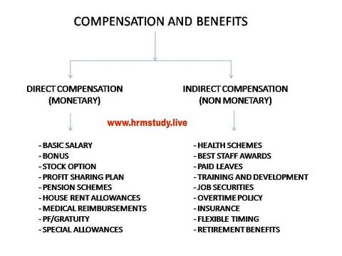

Slide 15
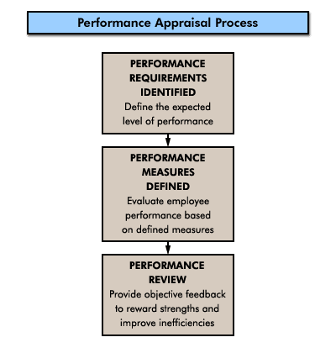

Slide 17
Managerial Function
Planning
Organizing
Directing
Controlling

Slide 18
Planning
set goals and objectives of an organization
Formulate policies and procedures
foresee vacancies
set the job requirements
decide the recruitment sources

Slide 19
Organizing
develop and design the structure of the organization
Employees are grouped into positions or activities
Allocate different functions to different persons
Delegate authority

Slide 20
Directing
Managers instruct, guide & oversee the performance
Motivating employees for achievement of goals

Slide 21
Controlling
Monitoring activities as per planning
Examination of goals achieved
Last step in management function

Slide 22
Advisory Function
Top Management Advice - policies and procedures
Departmental Head advice - job design, job description, recruitment, selection, appraisals.

