Slide 1
DEMAND
THEORY OF DEMAND
DEFINITION OF DEMAND
DEMAND CURVE
MOVEMENT & SHIFT IN DEMAND CURVE

Slide 2
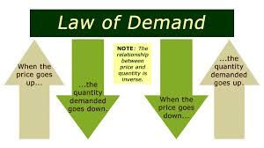
Theory of Demand
Law of Demand states that there is an inverse relationship between the price and the quantity demanded for a commodity when other thing being constant.
The desire to own something AND the ability to pay for it.

Slide 3
Definition
Demand means a consumer’s desire to purchase goods and services and
Willingness to pay a price for a specific good aur service. And
all the other factor constant, and increase in the price of good or service
Will decrease the quantity demanded, and vice versa.

Slide 4
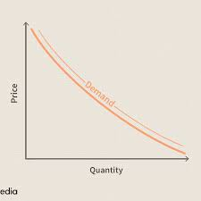
Demand Curve
Demand Curve means it is a graphic representation of the demand schedule.
Acc. To Lipsey “The curve, which shows the relation between the price of a commodity and the amount of that commodity the consumer wishes to purchase is called demand curve”.

Slide 5
Types of Demand Curve
They are of 2 types
Individual Demand Curve
Market Demand Curve

Slide 6
Individual Demand Curve
The demand curve is a curve drawn with vertical axis is the price axis, measuring the price per unit of the commodity.
The individual demand curve represents the quantity of a good that a consumer will buy at a given price, holding all else constant.

Slide 7
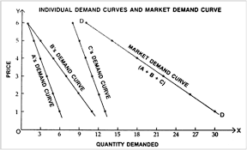

Slide 8
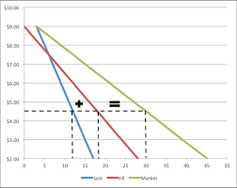
Market Demand Curve
The Market demand curve is the summation of all the individual demand curve in a given market. It show the quantity demanded of the good by all individuals at varying price points.
The market demand curve typically graphed and downward sloping because as price increases the quantity demanded decreases.

Slide 9
SHIFT IN DEMAND CURVE
A shift in demand means at the same price, consumers wish to buy more. A movement along the demand curve occurs following a change in price.
Movement along the demand curve
A change in price causes a movement along the demand curve. It can either be contraction (less demand) or expansion/extension. (more demand).
Demand curves shift around, indicating changes in other variables.
The main determinants of demand are consumer preferences, information, income, price expectations, population, and the prices of the related goods.

Slide 10
