Slide 1
Capital Asset Pricing Model
By
Dr. Manoj Kumar Dash
Asst. Prof. MATS University, Raipur.

Slide 3
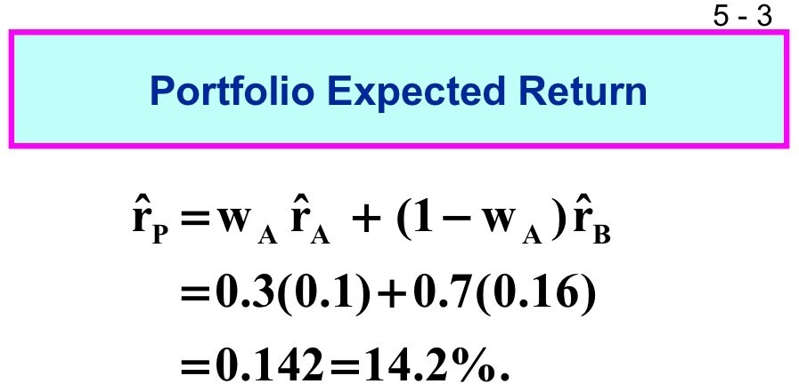

Slide 4
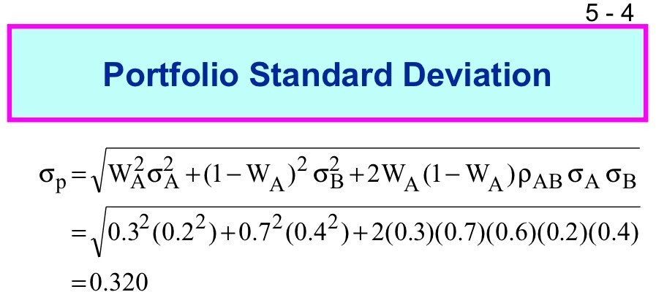

Slide 9
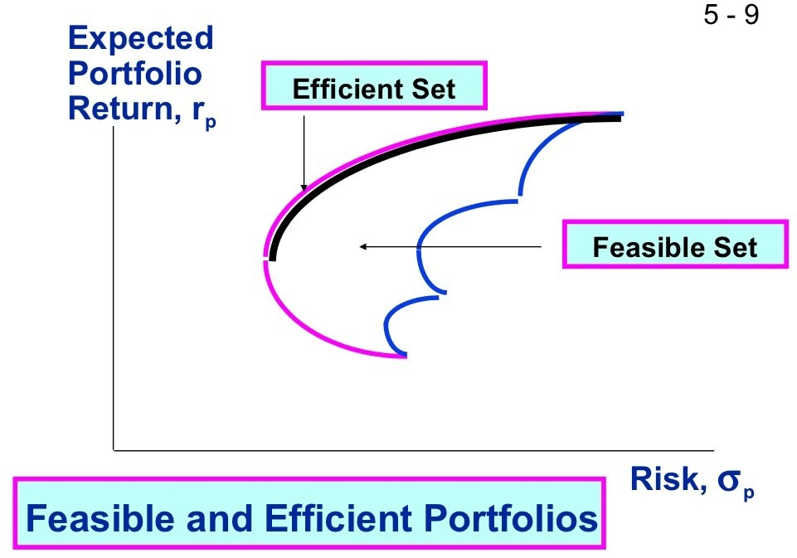

Slide 11
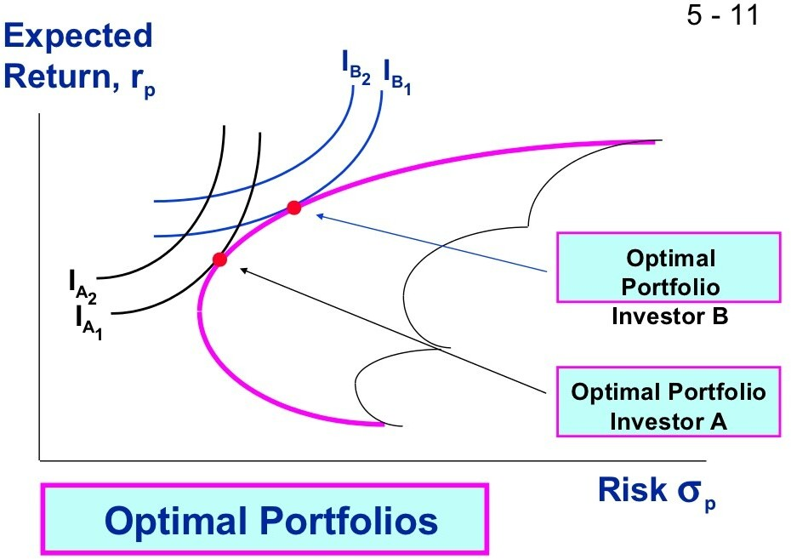

Slide 13
Capital Asset Pricing Model
CAPM –Developed in 1960
By Willium Sharpe , John Lintiner and Jan Mossin
It is called as Sharpe John Mossiin CAPM
CAPM is an extension of the portfolio theory of Markowitz
The portfolio theory explain how rational investors should build the efficient portfolio and select the optimum portfolio
In CAPM derived the relationship between the expected return and risk of individual security and portfolio as well in the capital market

Slide 15
Assumption of CAPM
Investors are make their investment decision based on risk return assessment measured in the term of expected return and SD of return
The purchase and sale of a security can be undertaken infinitely divisible unites
Purchase and sales by a single investors can not affect the prices as there is a perfect completion market where investors in total determine the prices by their action
investors have identical expectation with regard to decision period and decision inputs such as identical holding period, identical expectation regarding expected returns , variance of returns and covariance of all pairs of securities.

Slide 16
Assumption of CAPM
There is no transaction cost, the transactions cost are very small they are probable of minor importance in investment decision making
There is no personal Taxes, Alternatively the tax rate on dividend income and capital gain are same, thereby making the investors indifferent of the form in which the return on investment is received.
The Investors can lend and borrow any amount of funds desired at a rate of interest equal to the rate for risk less securities.
The investors can sell short any amount of any share.
Investors shares homogeneity of expectations. This is implies that

Slide 20
Expected return = price of time + (Price of risk) (amount of risk)

Slide 22
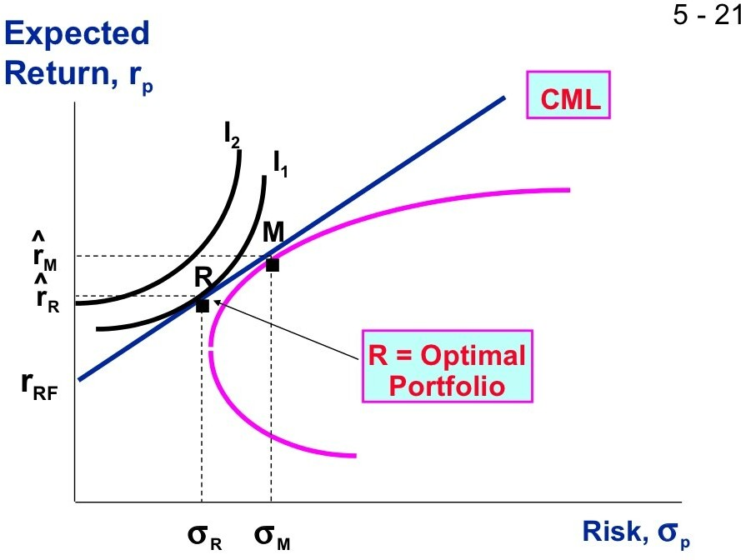

Slide 23
The relationship between risk and return established by security market line is called the CAPM
Basically it is a linear relationship
Higher the beta value, higher would be risk in security, Hence larger would be returns expected by the investors

Slide 24
E(r) = Rf + B (Rm -Rf)
E(r)-Rf= B(Rm-Rf)

Slide 29
Difference Between the SML and CML
Both SML and CML postulates a linear relationship between the risk and returns
SML | CML
Risk is defined as systematic risk and measured by Beta | Risk is defined as total risk and measured by Standard deviation
SML is valid for all portfolio and individual security | CML is valid for only for efficient portfolio
SML is based on CAPM | CML is based on market capital theory

Slide 33
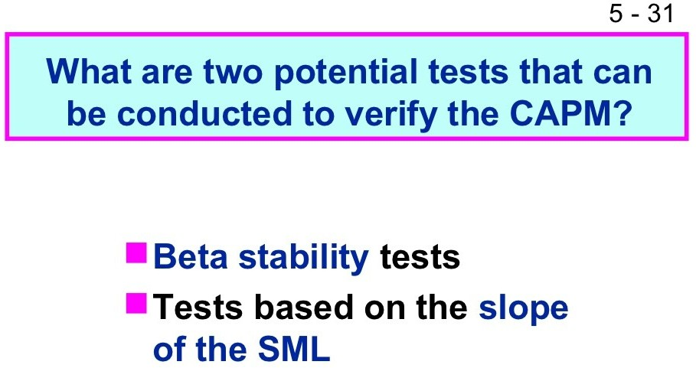

Slide 39
Arbitrage Pricing Model
Developed by the Stephen Ross in 1970
it is alternative model to CAPM,
Extension of the CAPM
The basic assumption if this theory is that security returns are related to unknown number of the unknown factors known as risk factor.

