Slide 1
Income Tax Law & Practise (Basics)
Duna Jogeswar Rao

Slide 2
Income Tax
Income tax
Income tax is a direct tax that a government levies on the income of its citizens. The Income Tax Act, 1961, mandates that the central government collect this tax. The government can change the income slabs and tax rates every year in its Union Budget.
Income does not only mean money earned in the form of salary. It also includes income from house property, profits from business, gains from profession (such as bonus), capital gains income, and 'income from other sources'. The government also often provides certain leeway such that various deductions are made from an individual's income before the tax to be levied is calculated.
Income Tax Returns
Income Tax Returns (ITR) form are the basis of calculating a person's income tax. It is a statement showing the status of a person, all their sources of revenue, deductions and, lastly, the tax payable or tax refund, if any.

Slide 3
History of Income Tax in India
In India, such tax was first introduced in 1860 by Sir James Wilson to meet the government’s problems due to the 1857 Military Mutiny.
A new income tax was introduced in 1918 and it was then replaced by other new Act that was passed in 1922.
This Act stayed in effect with various changes up to the assessment year 1961-62.
Finally, the Income Tax Act, 1961 was passed in consultation with the Ministry of Law. With 1 April 1962, the Income Tax Act 1961 was brought into effect. It refers to entire India and to Sikkim which includes Jammu & Kashmir.
Since 1962 the Union Budget has made several far-reaching changes each year in the Income Tax Act.
Bifurcated Central Board of Revenue and a separate Direct Tax Board is known as CBDT (Central Board of Direct Taxes) established under the Central Board of Revenue Act, 1963.
The principal tax enactment in India is the Parliament’s Income Tax Act, approved in 1961, that imposes a tax on people’s income.

Slide 4
Definition of Assessee
As per S. 2(7) of the Income Tax Act, 1961, unless the context otherwise requires, the term “assessee” means a person by whom any tax or any other sum of money is payable under this Act, and includes,-
(a) every person in respect of whom any proceeding under this Act has been taken for the assessment of his income or assessment of fringe benefits or of the income of any other person in respect of which he is assessable, or of the loss sustained by him or by such other person, or of the amount of refund due to him or to such other person;
(b) every person who is deemed to be an assessee under any provision of this Act;
(c) every person who is deemed to be an assessee in default under any provision of this Act.
From above definition, we can construe that normally the term ‘Assessee’ is considered as one who is supposed to pay tax under the Income Tax Act, 1961.

Slide 5
Definition of Person
As per Section 2(31) of Income Tax Act, 1961, unless the context otherwise requires, the term “person” includes:
(i) an individual,
(ii) a Hindu undivided family,
(iii) a company,
(iv) a firm,
(v) an association of persons or a body of individuals, whether incorporated or not,
(vi) a local authority, and
(vii) every artificial juridical person, not falling within any of the preceding sub-clauses.

Slide 6
Assessment Year
As per S.2(9) of the Income Tax Act, 1961, unless the context otherwise requires, the term ‘assessment year’ means the period of twelve months commencing on the 1st day of April every year. during which an assessee is required to file the return of income (ITR) for the previous year and the ITO has to initiate assessment proceedings for such returned income and tax thereon.
Now assessment year is 2022-23.

Slide 7
Previous Year
For Income Tax Act 1961, the previous year is defined as the financial year which immediately precedes the assessment year. In case the source of income is new or the business set up is new, the previous year for that entity will start from the date of setting up of that business or profession or from the date when the source of income of this new existence starts and ends in the said financial year.

Slide 8
The exception to Previous Year:
Tax on Income earned in the previous year is paid in the assessment year. However, there are a few exceptions where the tax on Income earned in the previous year is paid in the previous year itself. These exceptions are: 1. Income earned by a non resident through a shipping business in India 2. Income earned by the person who is leaving India permanently or for a long period of time. 3. Income earned by those bodies which are formed for a short period of Time. 4. Income earned by those person who are likely to transfer their property in order to avoid tax 5. Income earned from a discontinued business.

Slide 9
Definition of Income
Income is the money received by a person (individuals or business) periodically on daily, weekly, monthly, or yearly basis. Income includes monetary as well as non-monetary values of allowances and perquisites. All income is taxable under income tax unless expressly exempted.
According to Section 2(24) of Income tax Act, 1961 Income includes following which in this link
https://incometaxmanagement.com/Pages/Tax-Ready-Reckoner/Tax-Concepts/Income-Sec-2-24.html

Slide 10
The basic features of Income
(i) Income can be received at a periodical basis whether daily, weekly, monthly or yearly
(ii) Income can be taxed at receipt or accrual basis (iii) Income tax law does not distinguish between legal or illegal income (iv) Income can be received on temporary or permanent basis
(v) Income received when in lump sum or in installment basis will be held liable to tax.
(vi) Under Income Tax Act, Income includes revenue or capital gains and even includes losses.
(vii) In case of individuals or HUF, gift received above Rs. 50000 during the financial year will be considered as income.

Slide 11
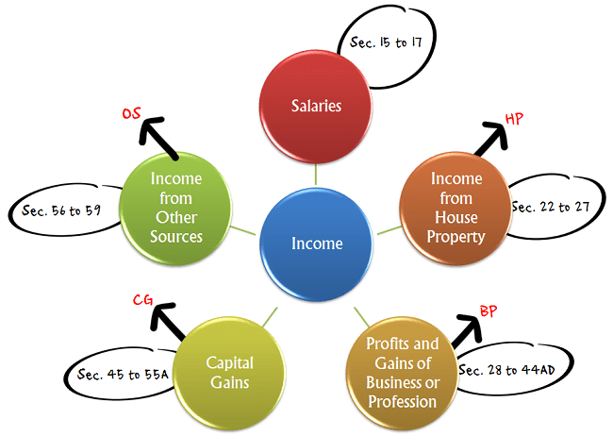
Sources of Income

Slide 12
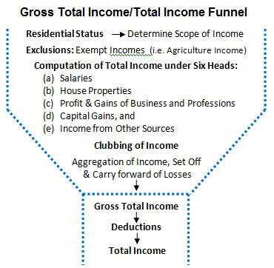

Slide 13
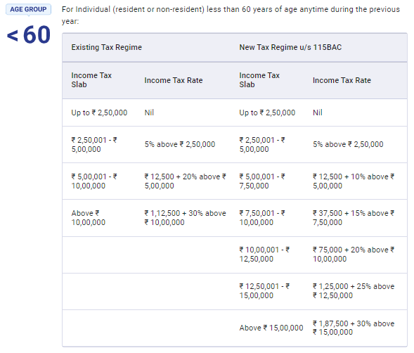

Slide 14
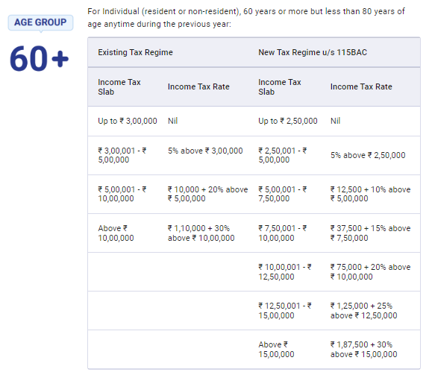

Slide 15
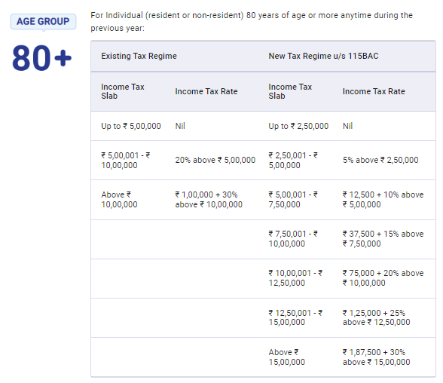

Slide 16
Note:
1. The rates of Surcharge and Health & Education cess are same under both the tax regimes
2. Rebate u/s 87-A Resident Individual whose Total Income is not more than ₹ 5,00,000 is also eligible for a Rebate of up to 100% of income tax or ₹ 12,500, whichever is less. This Rebate is available in both tax regi

Slide 17
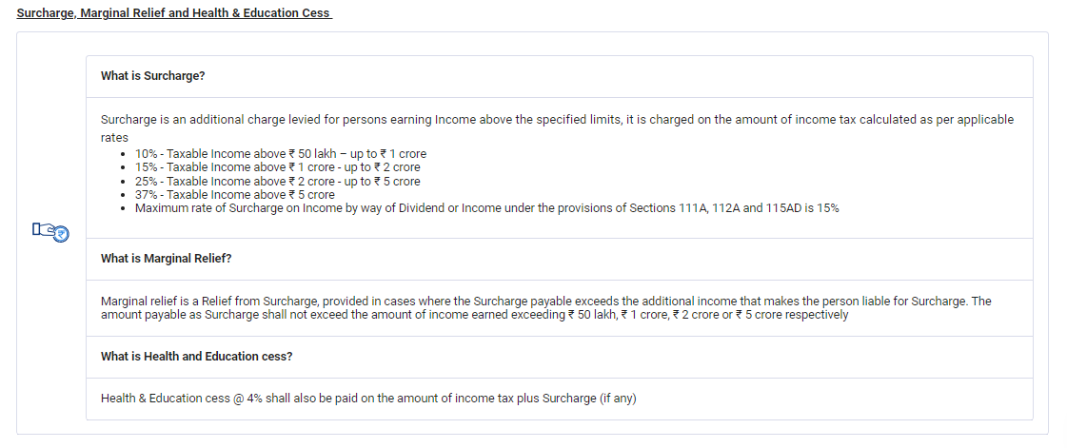

Slide 18
Best of Luck

