Slide 1
MSMSR Department Achievement Report
Prepared By:-
Dr. Akshita Sharma

Slide 2
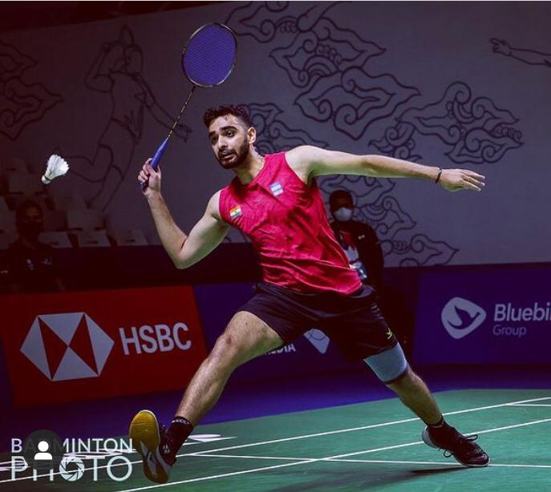
Sport Achievements:-
Amitesh Mishra
BBA 6th Semester
First indian to finish 16th in long distance race in world championship in seniormen.
Fastest long distance skater from India
Ishaan Bhatnagar
BBA 4th Semester
(World top 100 Ranked Badminton Player)
student with Tanisha Christo
of Goa won Gold medal in mixed
double badminton competition
at Syed Modi International
Badminton competition.
Mr. Shourya Manik
BBA 2nd semester
An achiever in “All India Mens Tennis
Tournament “ Singles secured 1st Position and 2nd Position in Doubles

Slide 3
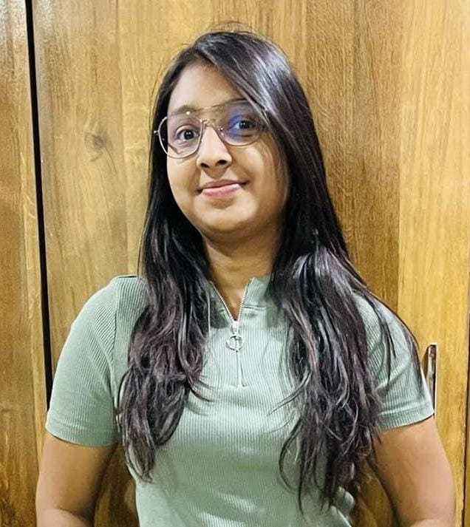
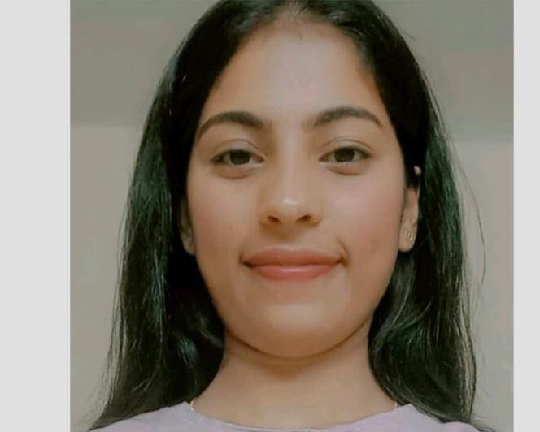
Academic Achievement (BBA 1st semester):-
Ms. Archee Agrawal Ms. Shirin Rizvi Ms. Sanjana Dase
(BBA 1st sem.) (BBA 1st sem.) (BBA 1st sem.)
Scored - (87.55%) Scored - (85.11%) Scored - (82.88%)
Marks- 394/450 Marks- 383/450 Marks- 373/450

Slide 4
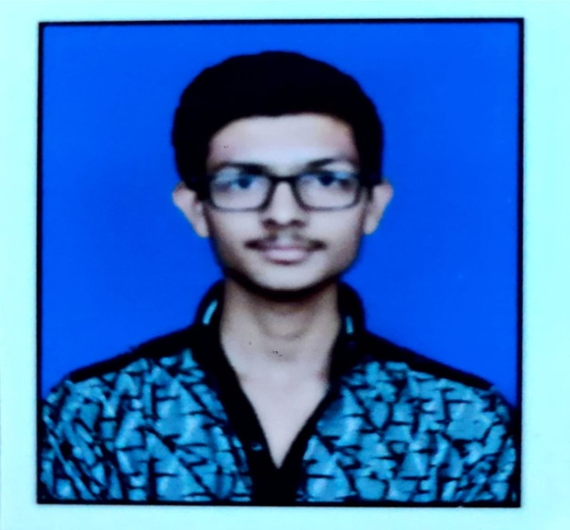
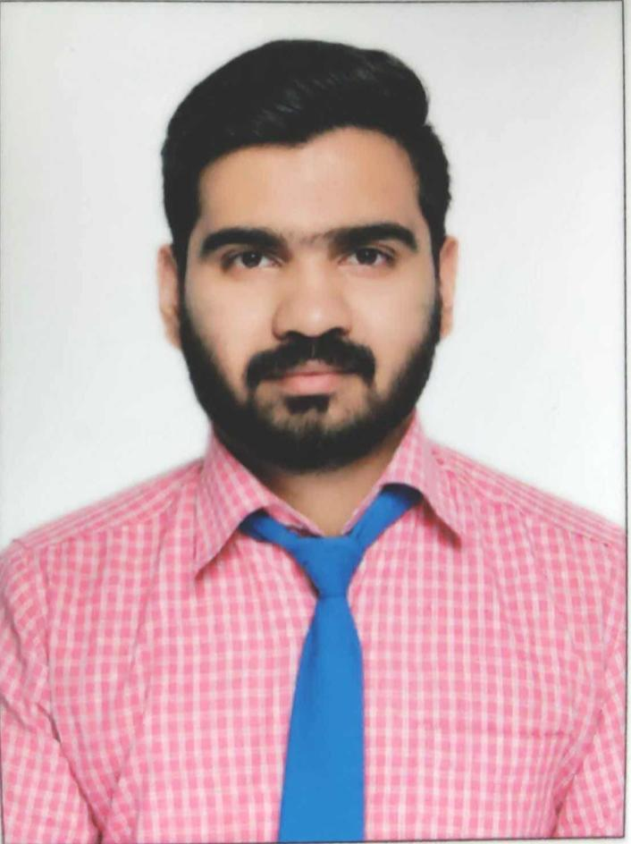
Academic Achievement(BBA 3rd Semester):-
Ms. Harsat Khan Mr. Aman Agrawal Mr. Adnan Manoor Saify
(BBA 3rd sem.) (BBA 3rd sem.) (BBA 3rd sem.)
Scored - (77.78%) Scored -(74.22 %) Scored - (71.33%)
Marks-350/450 Marks-334/450 Marks- 321/450

Slide 5
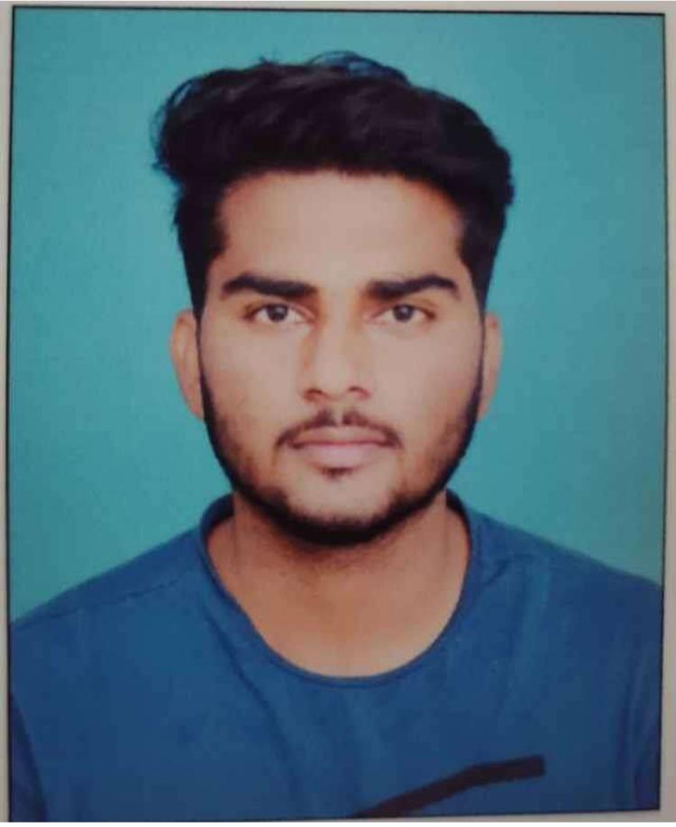
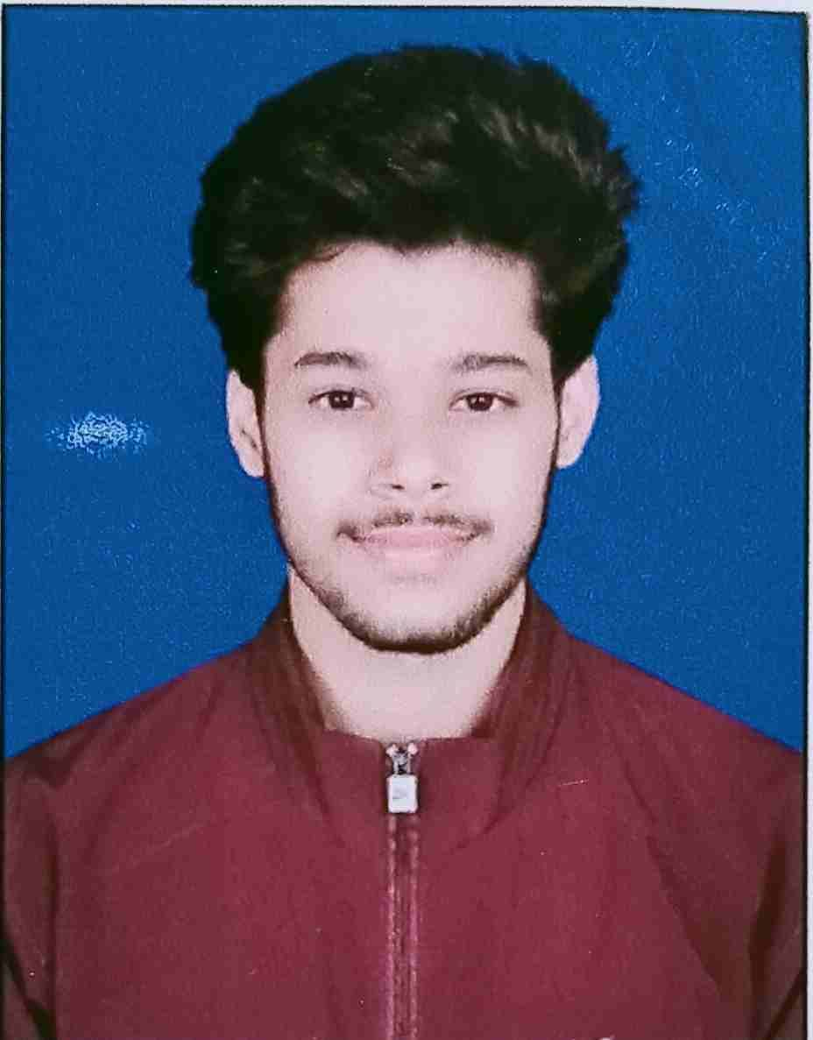
Academic Achievement(BBA 5th Semester):-
Ms. Nirmalya Nair Mr. Rohan Yadav Mr. Rishi Tiwari
(BBA 5th sem.) (BBA 5th sem.) (BBA 5th sem.)
Scored - (88%) Scored - (81%) Scored - (80.6%)
Marks- 440/500 Marks- 405/500 Marks- 403/500

Slide 6
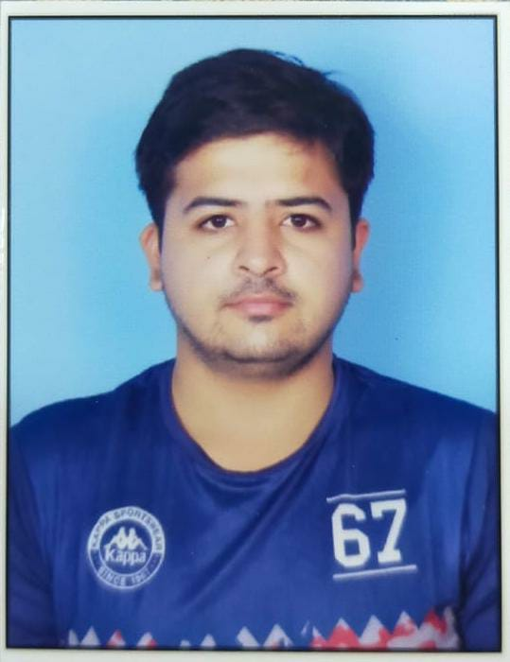
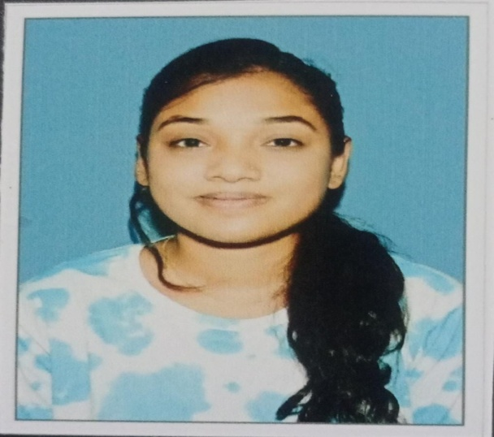
Academic Achievement(MBA 1st semester):-
Mrs. Meenal Shrivas Ms. Ankur Sharma Ms. Ruchita Patel
(MBA 1st sem.) (MBA 1st sem.) (MBA 1st sem.)
Scored - (85.42%) Scored - (80.57%) Scored - (80%)
Marks-598/700 Marks-564/700 Marks- 560/700

Slide 7
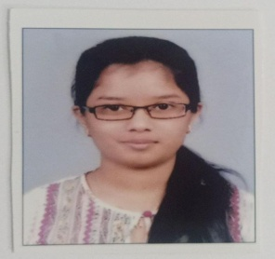
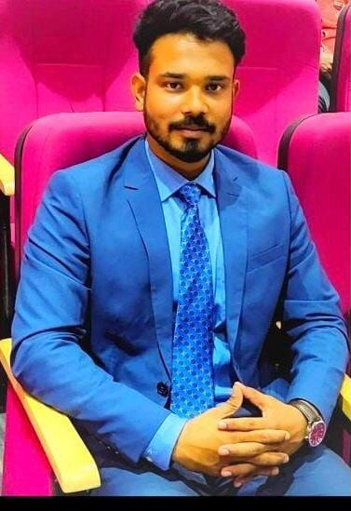
Academic Achievement(MBA 3rd semester):-
Ms. Khushboo Dalamia Ms. K.Kriti Rao Mr. Sampan Barman
(MBA 3rd sem.) (MBA 3rd sem.) (MBA 3rd sem.)
Scored - (84.71%) Scored - (78.57%) Scored - (78.14%)
Marks- 593/700 Marks-550/700 Marks-547/700

Slide 8
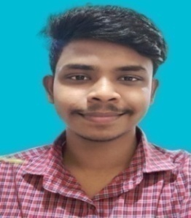
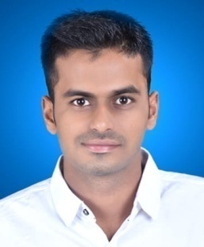
Placement of Students:-
Ms. Ruma Dutta
BBA Batch 2018-2021
Placed in “Sri Ram Finance”
Ms. Nikita Banjare
MBA Batch 2020-2022
Placed in “CiEL HR”
Package- 1.8 lakhs
Mr. Emmanual Nath
BBA Batch 2019-2022
Placed in “TASS - Rama Motocorp”
Mr. Shibanand Padhi
BBA Batch 2019-2022
Placed in “Konsole Indya”

Slide 9
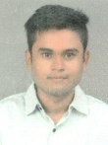
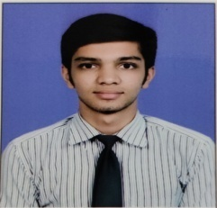
Placement of Students:-
Mr. Richardson Dani
MBA Batch 2019-2021
Placed in “CiEL HR”
Package- 2.88 Lakhs
Mr. Rahul Bisen
MBA Batch 2020-2022
Placed in “ESAF Small Finance Bank ”
Mr. Chirantan Ghosal
MBA Batch 2020-2022
Placed in “CiEL HR”
Mr. Shubham Daga
BBA Batch 2019-2022
Placed in “Byju’s”

Slide 10
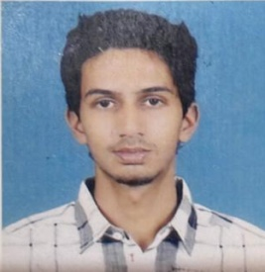
Placement of Students:-
Mr. Sampan Barman
MBA Batch 2020-2022
Placed in “ESAF Small Finance Bank ”
Package- 3.82 Lakhs
Ms. Akhita Tayal
MBA Batch 2020-2022
Placed in “Laurea Peoples Signature Sdn Bhd – Malaysia”
Mr. Archit Anupam Mishra
MBA Batch 2020-2022
Placed in “CiEL HR “
Package- 2.88 Lakhs
Mr. K. Kirti Rao
MBA Batch 2020-2022
Placed in “CiEL HR “
Package- 1.8 Lakhs

Slide 11
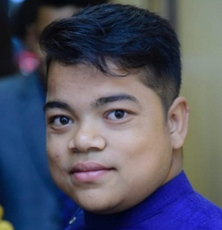
Placement of Students:-
Mr. Dipesh Paul
BBA Batch 2019-2022
Placed in “Rama Motocorp”
Package- 1.44 Lakhs
Mr. Zeenat Khatun
BBA Batch 2019-2022
Placed in “Technoblast Mineral Resources ”
Package- 1.8 Lakhs CTC
Mr. Sahil Raj
MBA Batch 2020-2022
Placed in “Byju’s”
Package-2.25 lakhs
Mr.Ayush Bhattacharya
BBA Batch 2019-2022
Placed in “Rama Motocorp”
Package-1.44 Lakhs

Slide 12
Placement of Students:-
Mr. Deepak Upadhayay
BBA Batch 2019-2022
Placed in “Rama Motocorp”
Package- 1.44 Lakhs
Mr. Rameshwar Yadav
MBA Batch 2020-2022
Placed in “Byju’s”
Package- 10 Lakhs

