Slide 1
IOT Platforms Design
Methodology
Dr. Snehlata Barde
Profesor & HoD, MSIT
MATS University,Raipur

Slide 2
Introduction
Designing IoT systems can be a complex and challenging task as these systems involve interactions between various components such as IoT devices and network resources, web services, analytics components, application and database servers.
IoT system designers often tend to design IoT systems keeping specific products/services in mind.
So that designs are tied to specific product/service choices made. But it make updating the system design to add new features or replacing a particular product/service choice for a component becomes very complex, and in many cases may require complete re- design of the system.

Slide 3
Introduction
Here we discuss a generic design methodology for IoT system design which is independent of specific product, service or programming language.
IoT systems designed with the proposed methodology have reduced design, testing and maintenance time, better interoperability and reduced complexity.'

Slide 4
IOT Platforms Design Methodology
It includes:
Purpose & Requirements Specification
Process Specification
Domain Model Specification
Information Model Specification
Service Specification

Slide 5
IOT Platforms Design Methodology
IoT Level Specifications
Functional view Specification
Operational View Specification
Device & component Integration
Application Development

Slide 6
Purpose & Requirements Specification
The first step in IoT system design methodology is to define the purpose and requirements of the system. In this step, the system purpose, behavior and requirements are captured.

Slide 7
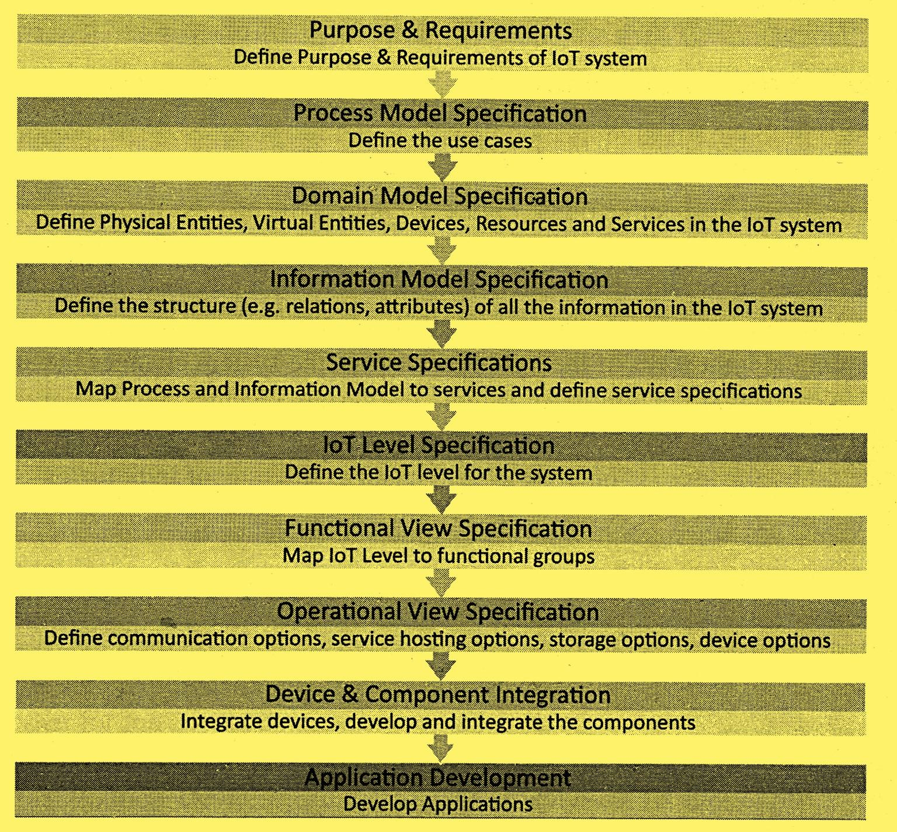
Purpose & Requirements Specification
Purpose : A home automation system that allows controlling of the lights in a home remotely using a web application. Behavior : The home automation system should have auto and manual modes. In auto mode, the system measures the light level in the room and switches on the light when it gets dark. In manual mode, the system provides the option of manually and remotely switching on/off the light.
System Management Requirement : The system should provide remote monitoring and control functions.

Slide 9
Thank you
51

