Slide 1
Bresenham's Circle Drawing Algorithm
Dr. Snehlata Barde
Professor & HoD, MSIT
MATS University,Raipur

Slide 2
Contents:-
Bresenham's Circle Drawing Algorithm
Introduction
Algorithm
Example

Slide 3
Introduction : Introduction
Bresenham's Circle drawing algorithm is a circle drawing algorithm that selects the nearest pixel position to complete the arc.
The Unique part of these algorithms is that is uses only integer arithmetic makes it significantly, faster than other algorithms using floating point arithmetic in Classical processors.

Slide 4
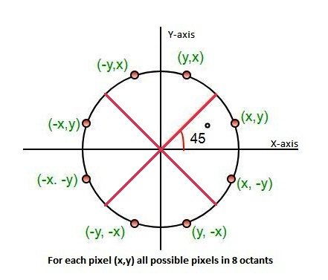
Algorithm :
As per Eight way symmetry property of Circle, circle can be divided into 8 octants each of 45 degree.
The following image illustrates the 8 octants with corresponding pixel

Slide 5
Process:-
Given-
Centre point of Circle = (X,Y)
Radius of Circle = R
Equation of circle
X2+Y2=R2

Slide 6
Wr woerk on 90 to 45 octant
Step-01:
Assign the starting point coordinates (X , Y) as-
Step-02:
Calculate the value of initial decision parameter d as -
d = 3 - 2 * R
X = 0
Y = R

Slide 7
Step-03:
Assume, the initial coordinates are (X , Y)
The next coordinates will be (Xk , Yk)
Now, we will find the next point of the first octant according to the value of the decision parameter (dk).
Step-04:
Now, we follow two cases-
Case 1: If
dk < 0

Slide 8
Then
Xk = X + 1
Yk = Y
dk = (d + 4 * Xk + 6)
Case 2: If
dk >= 0
then
xk = X +1
yk = Y - 1
dk = d + 4(Xk - Yk) + 10

Slide 9
Step-05:
If the center coordinates (X , Y) is not at the origin (0, 0), then we will draw the points as follow-
X coordinate = Xc + X
Y coordinate = Yc + Y
{Xc and Yc represents the current value of X and Y coordinate}
Step-06:
We repeat step 4 and 5 until we get x>=y.

Slide 10
Example :
Question : The radius of a circle is 8, and center point coordinates are (0, 0). Apply bresenham’s circle drawing algorithm to plot all points of the circle.
Solution :
Step 1:
The given stating points of the circle (x1, y1) = (0, 8)
Radius of the circle (r) = 8

Slide 11
Step 2:
Now, we will assign the starting point (x1, y1) as follows-
x1 = 0
y1 = r (radius) = 8
Step 3:
Now, we will calculate the initial decision parameter (d0)
d0 = 3 – 2 x r
d0 = 3 – 2 x 8
d0 = -13

Slide 12
Step 4:
The value of initial parameter d0 < 0. So, case 1 is satisfied.
Thus,
Xk = X + 1 = 0 + 1 = 1
Yk = Y = 8
dk = d + 4 * Xk + 6 = –13 + (4 x 1) + 6 = –3
Step 5:
The center coordinates are already (0, 0) so we will move to
next step.
Step 6:
Follow step 4 until we get x >= y.
–13 + (4 x 1) + 6 = –3

Slide 13
Table for all points of octant 1 :
d0 | dk | (Xk, Yk)
 |  | (0,8)
-13 | -3 | (1,8)
-3 | 11 | (2,8)
11 | 5 | (3,7)
5 | 7 | (4,6)
7 |  | (5,5)

Slide 14
Now, the points of octant-2 are obtained using the mirror effect by swapping X and Y coordinates.
Octant-1 Points Octant-2 Points
(0, 8) (5, 5)
(1, 8) (6, 4)
(2, 8) (7, 3)
(3, 7) (8, 2)
(4, 6) (8, 1)
(5, 5). (8, 0)
These are all points for Quadrant-1.
Here, all the points have been generated with respect to quadrant-1-

Slide 15
Quadrant-1 Quadrant-2. Quadrant-3. Quadrant-4
(X , Y) (-X ,Y) (-X,-Y) (X,-Y)
(0 , 8) (0 , 8) (0 ,-8) (0, -8)
(1 , 8) (-1 ,8) (-1 ,-8) (1 , -8)
(2 , 8) (-2 ,8) (-2 , -8) (2 , -8)
(3 , 7) (-3 ,7) (-3 , -7) (3 , -7)
(4 , 6) (-4 ,6) (-4 , -6) (4 , -6)
(5 , 5) (-5 ,5) (-5 , -5) (5 , -5)
(6 , 4) (-6 ,4) (-6 , -4) (6 , -4)
(7 , 3) (-7 ,3) (-7 , -3) (7 , -3)
(8 , 2) (-8 ,2) (-8 , -2) (8 , -2)
(8 , 1) (-8 ,1) (-8 , -1) (8 , -1)
(8 , 0) (-8 ,0) (-8 , -0) (8 , 0)
These are all points of the Circle.

